Slide 1
Pathways Overview
Eva Tweedy, DTM

Slide 2
Definitions
Pathways = the self paced education program in Toastmasters that we follow
Path = the specialized path (learning module) you choose to follow
Base Camp = the online interface/e-learning platform we use to access the program
Toastmasters.org = Toastmasters Int’l website where you access Base Camp and your account
TMD55.org = the district website where you can find trainings, resources, and info on local events

Slide 3
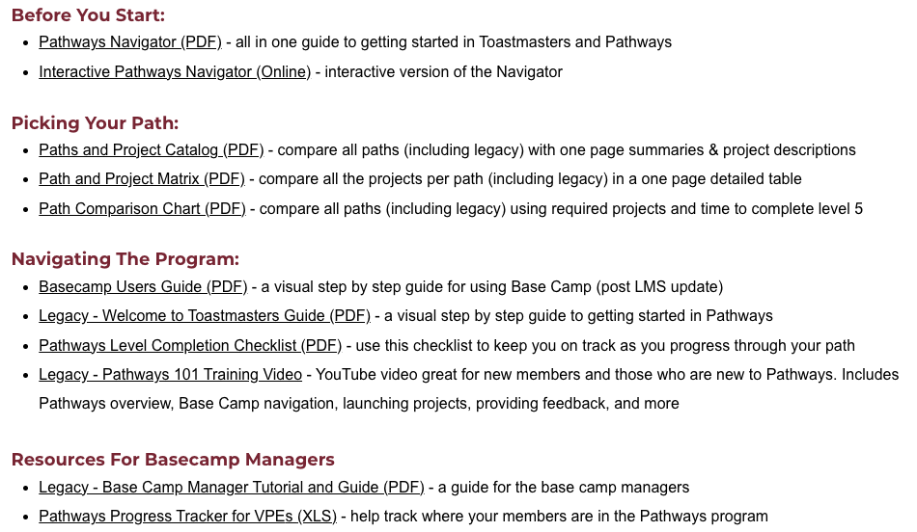
TMD55.org Pathways Resources

Slide 4
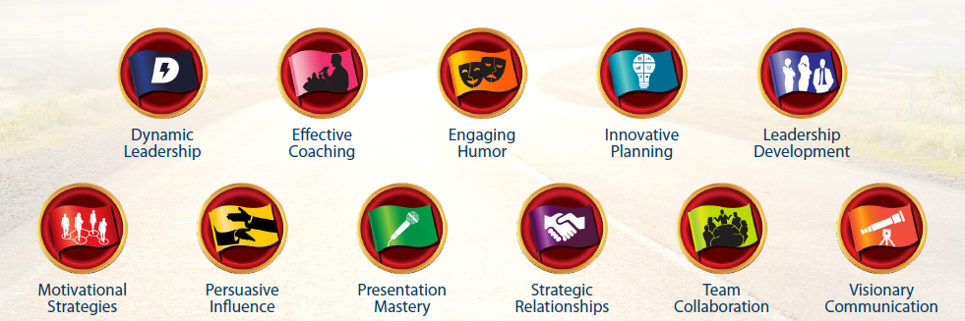
11 Paths (Legacy)

Slide 5
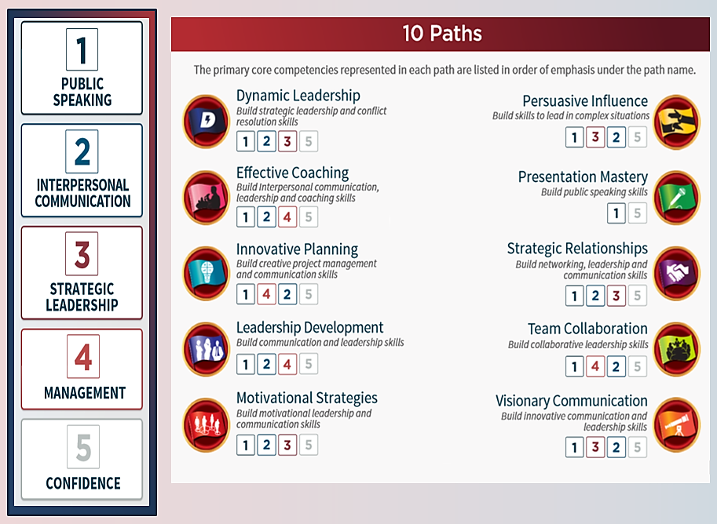
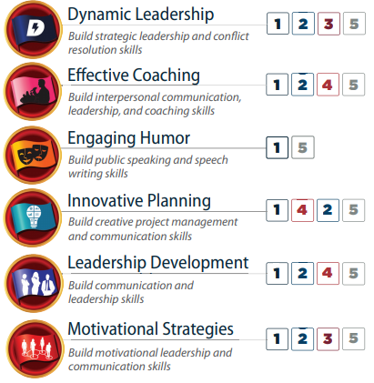
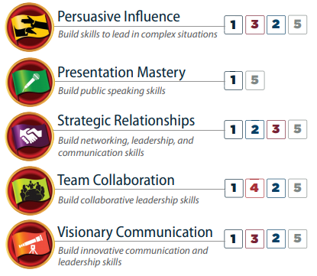






11 Paths
6 Paths
The primary core competencies represented in each path are listed in order of emphasis below.
Pathways Mentoring Program
Notes:
upcoming Pathways changes [emails.toastmasters.org]. You may remember that in March we announced that Base Camp, the online system where Pathways is accessed, is moving to a new learning management system (LMS) early next year.
The new LMS will launch with six paths:
Dynamic Leadership
Engaging Humor
Motivational Strategies
Presentation Mastery
Persuasive Influence
Visionary Communication
If you start a different path before the new LMS launches next year, you will still be able to access your educational content, complete projects, and receive credit for path and level completions. The content simply won’t look like updated Pathways content.

Slide 6
6 Paths
The primary core competencies represented in each path are listed in order of emphasis below.
Notes:
upcoming Pathways changes [emails.toastmasters.org]. You may remember that in March we announced that Base Camp, the online system where Pathways is accessed, is moving to a new learning management system (LMS) early next year.
The new LMS will launch with six paths:
Dynamic Leadership
Engaging Humor
Motivational Strategies
Presentation Mastery
Persuasive Influence
Visionary Communication
If you start a different path before the new LMS launches next year, you will still be able to access your educational content, complete projects, and receive credit for path and level completions. The content simply won’t look like updated Pathways content.

Slide 7


Updated Pathways (simplified to 6 paths)

Slide 8
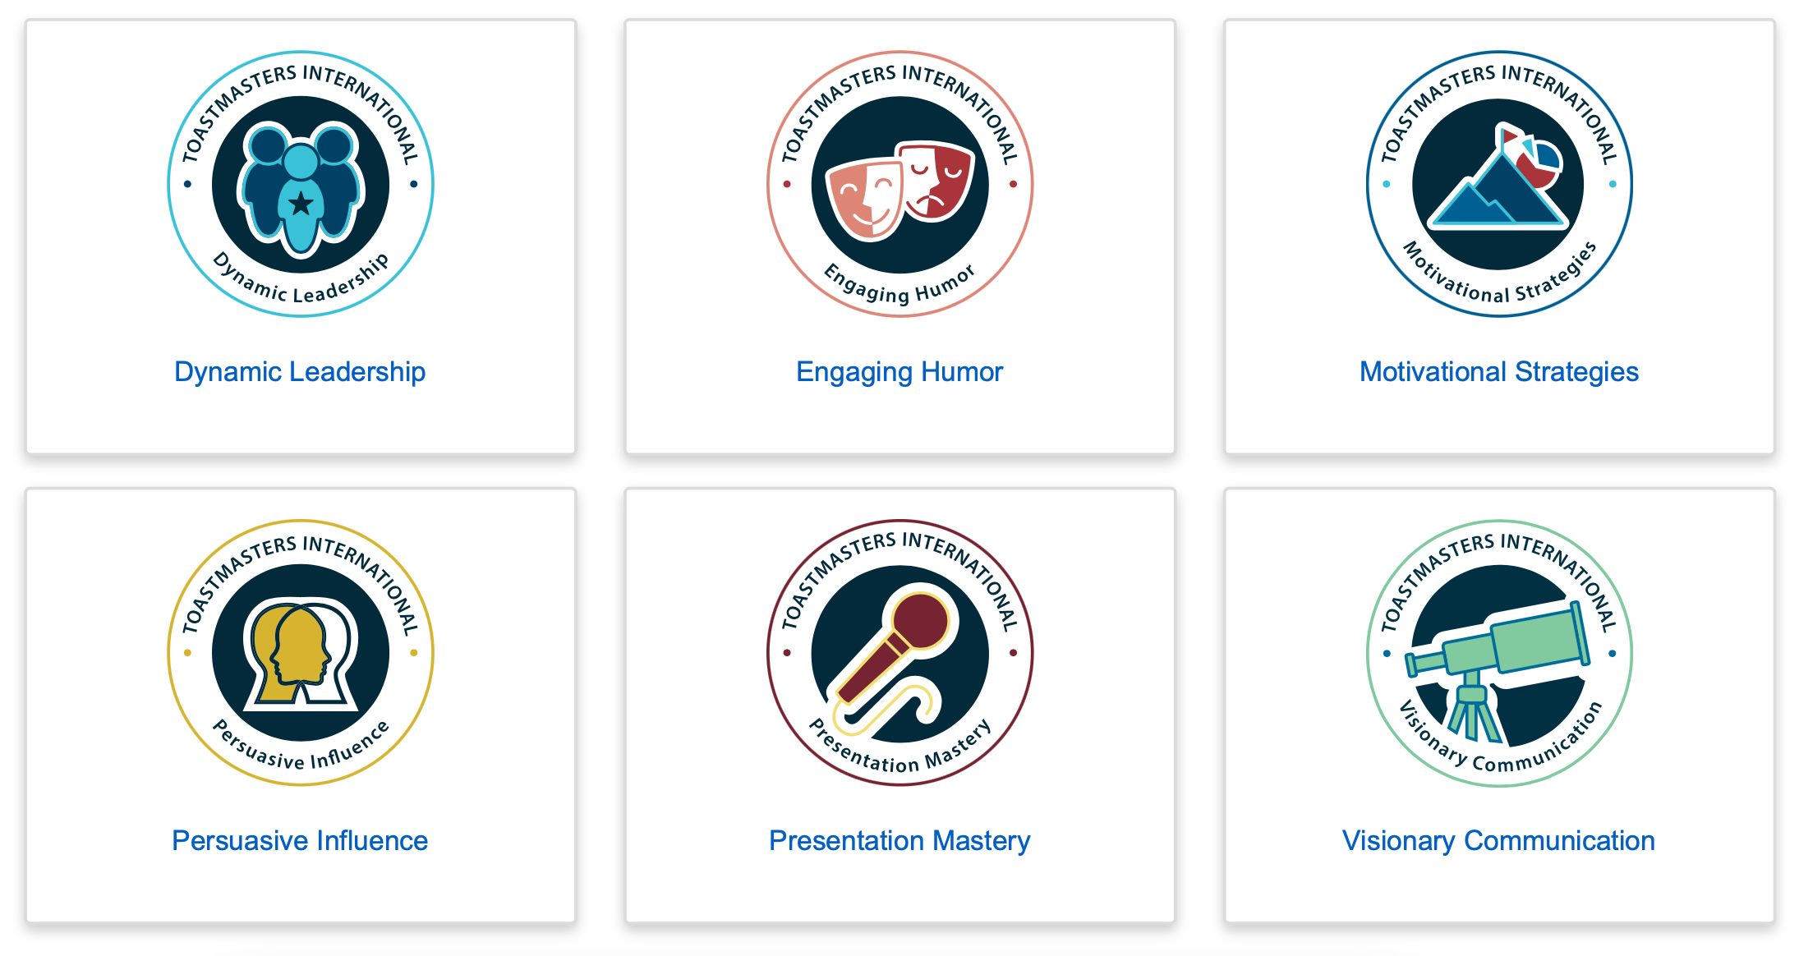
What are the Paths?

Slide 9
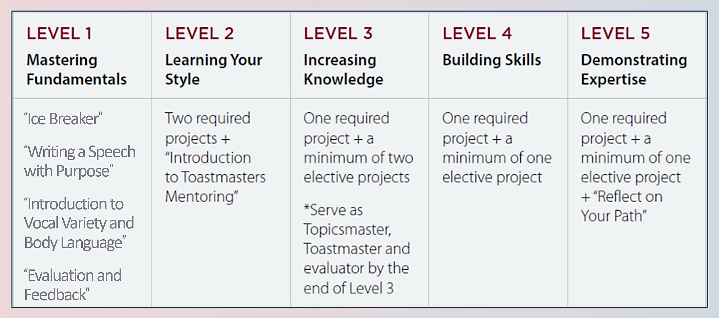
Levels and Projects
15 projects across all five levels — a combination of 11 required projects and 4 elective projects

Slide 10
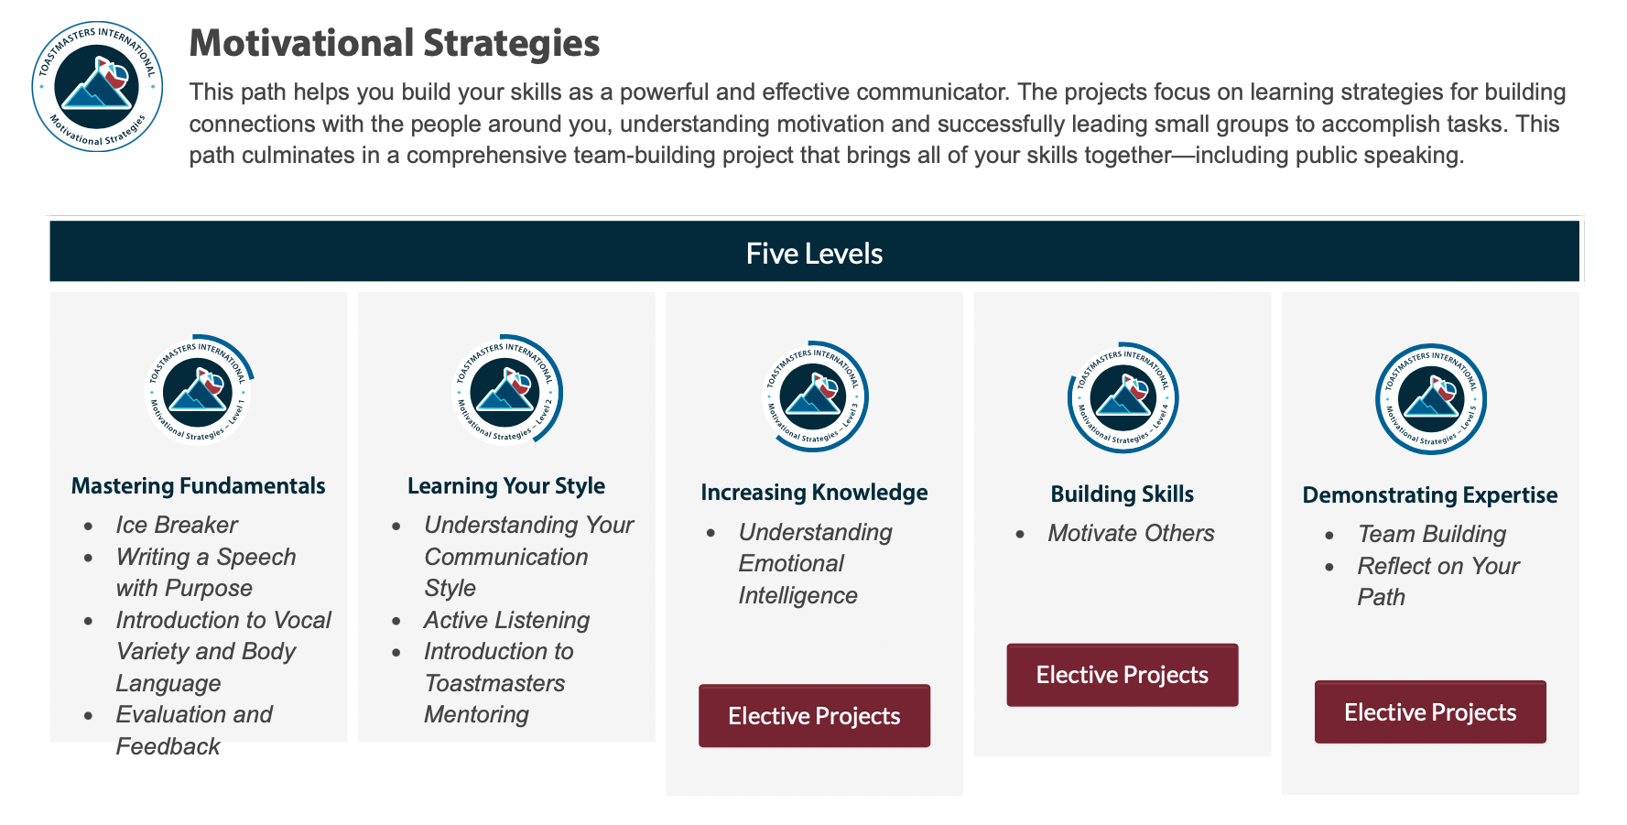

Slide 11
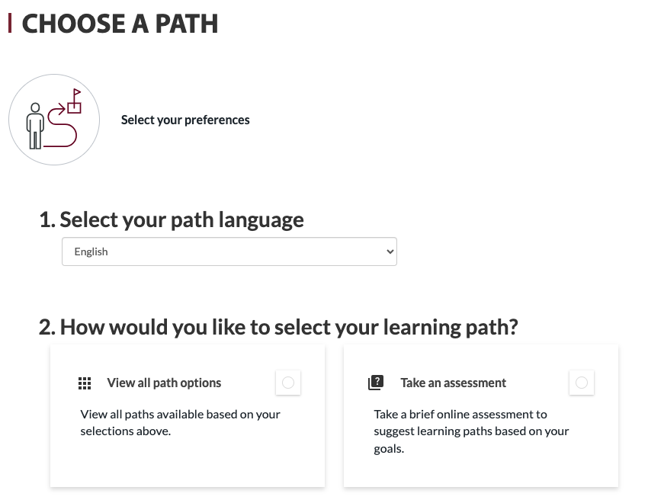
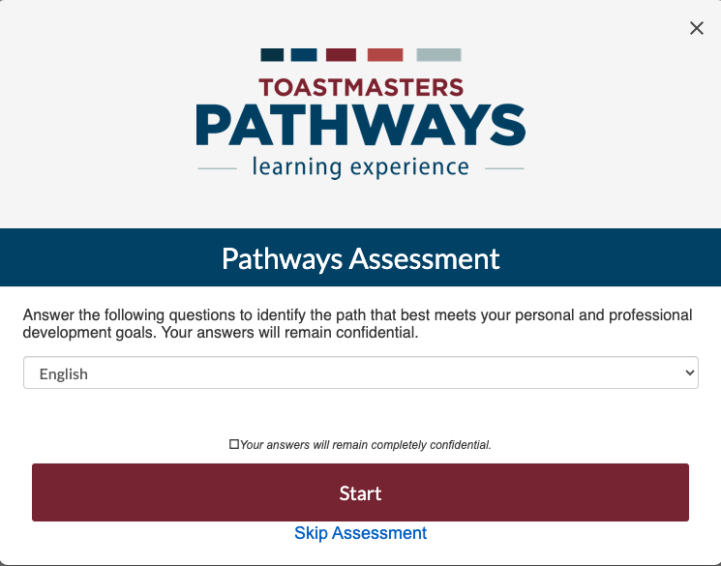
Picking a Path – the Assessment
When you go to choose your path, you will have the option to take an online assessment of your skills, interests, and goals. The assessment will recommend the three paths that best match your responses.

Slide 12
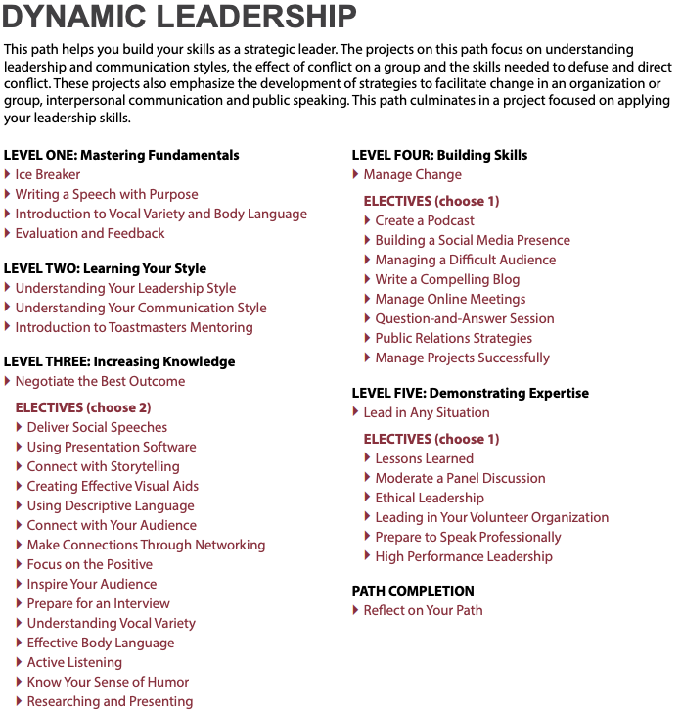
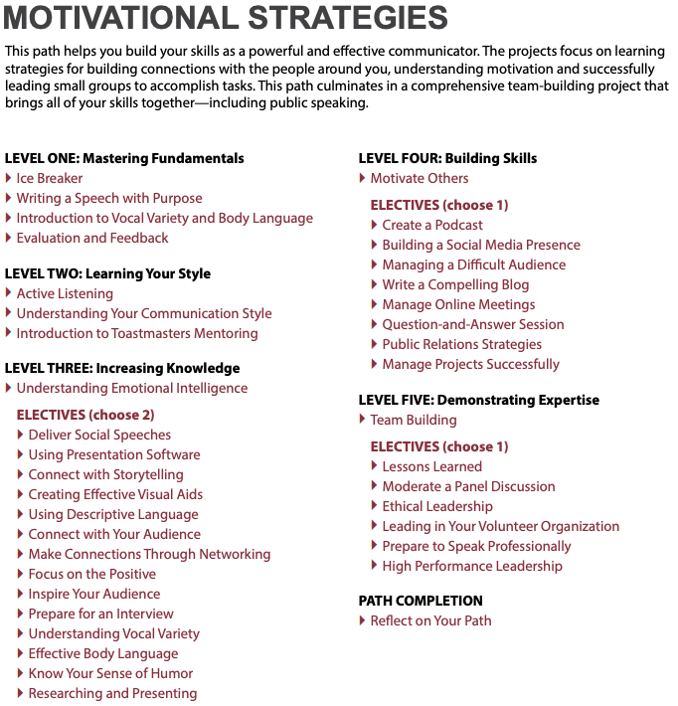
Picking a Path – the Catalog
Link to Catalog
You can use the catalog to compare descriptions and project breakdowns of each path to select the one you prefer. *Note: the electives are the same for all the paths – look at the required projects to help you choose a path.
VS

Slide 13
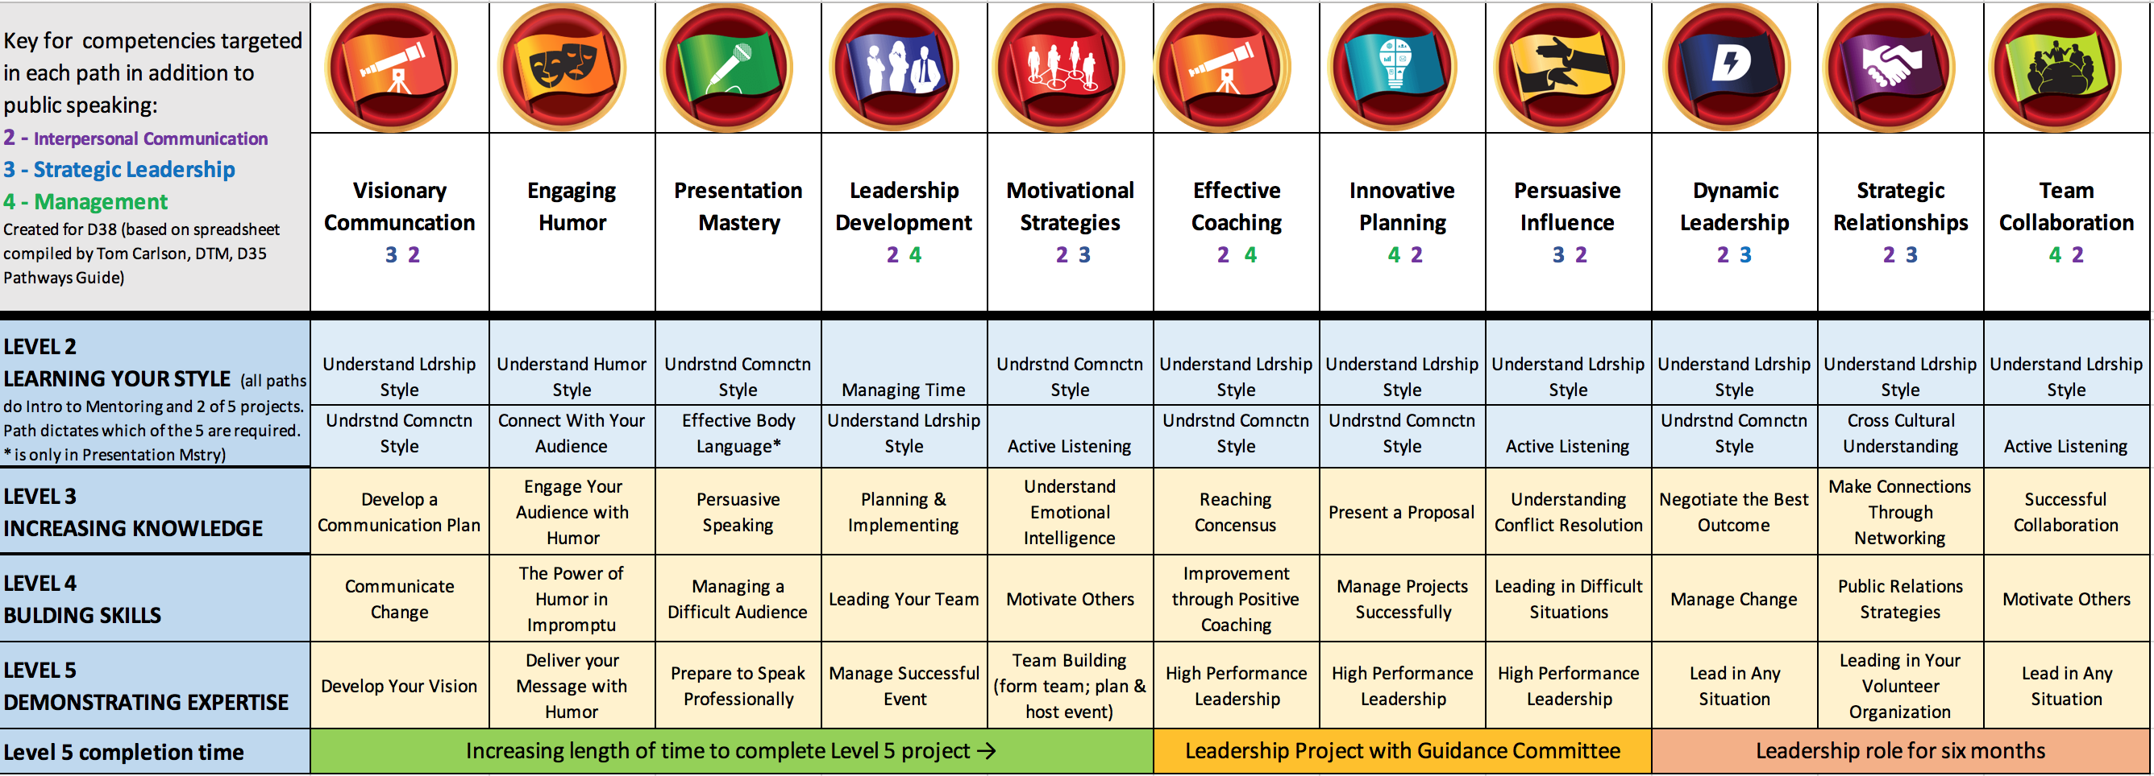
Picking a Path – Using the Chart
Created by D35 Tom Carlson, DTM

Slide 14
Picking a Path – Using the Chart
Paths represented by required projects and time to complete level 5
Created by D35 Tom Carlson, DTM
Created by D35 Tom Carlson, DTM
Leadership Project with guidance committee
Leadership role for 6 months

Slide 15
What are the Electives?
Connect with Storytelling
Connect with Your Audience
Creating Effective Visual Aids
Deliver Social Speeches
Effective Body Language
Focus on the Positive
Inspire Your Audience
Know Your Sense of Humor
Prepare for an Interview
Understanding Vocal Variety
Using Descriptive Language
Using Presentation Software
Researching and Presenting
Make Connections Through Networking
Write a Compelling Blog
Create a Podcast
Manage Online Meetings
Manage Projects Successfully
Public Relations Strategies
Question & Answer Sessions
Build a Social Media Presence
Ethical Leadership
High Performance Leadership
Leading in Your Volunteer Organization
Lessons Learned
Moderate a Panel Discussion
Level 3 Electives
Level 4 Electives
Level 5 Electives
Notes:
Choose 2 electives from Level 3 and one each from 4 & 5

Slide 16
Differences Between Updated and Legacy Paths
Updated Paths
Legacy Paths
Easy to see and understand side navigation
Complete Projects by clicking on a button
Speech Logs to help keep track of progress
Are being continuously enhanced
Include new role requirements
All navigation per project is done in the middle square
Must complete “Assess Your Skills – After” to complete project
No built in Speech Log
Don’t have new enhancements
Don’t have new role requirements

Slide 17
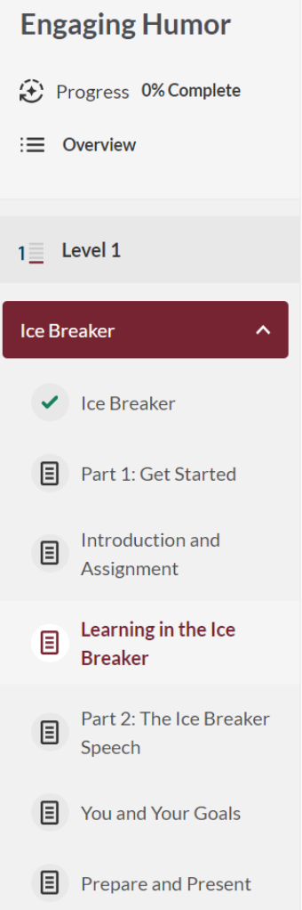
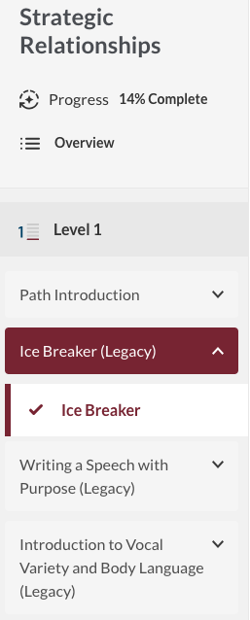
Differences Between Updated and Legacy Paths
Updated
Legacy

Slide 18
October 2025: Role & Speech Requirement Updates
Level | Meeting Roles | Presentation Requirements
Level 1 | Table Topics Speaker* Evaluator Timer OR Ah-Counter | None
Level 2 | Grammarian Topicsmaster Evaluator Toastmaster, Timer OR Ah-Counter | None
Level 3 | Toastmaster Evaluator Topicsmaster, Table Topics Speaker, OR Introductory Mentor** | Successful Club Series Presentation (Choose 1): Creating the Best Club Climate, Meeting Roles and Responsibilities, Keeping the Commitment, Going Beyond Our Club
Level 4 | Toastmaster General Evaluator Evaluator Table Topics Speaker, Topicsmaster, a Specialized Role***, OR repeat any above role | Successful Club Series Presentation (Choose 1): Finding New Members, Closing the Sale, How to Be a Distinguished Club, Toastmasters Educational Program Better Speaker Series Presentation (Choose 1): Beginning Your Speech, Concluding Your Speech, Controlling Your Fear, Impromptu Speaking, Selecting Your Topic, Know Your Audience, Organizing Your Speech, Creating an Introduction, Preparation and Practice, Using Body Language
Level 5 | General Evaluator (x2) Toastmaster (x2) Evaluator (x2) Table Topics Speaker, Topicsmaster, Ah-Counter, Timer, Grammarian, Club Mentor, a Specialized Role***, OR repeat any above role | Successful Club Series Presentation (Choose 1): Moments of Truth, Evaluate to Motivate, Mentoring Leadership Excellence Series Presentation (Choose 1): Service and Leadership, The Leader as a Coach, Developing a Mission, Motivating People, Building a Team, Delegate to Empower, Resolving Conflict, Visionary Leader, Values and Leadership, Goal Setting and Planning, Giving Effective Feedback

Slide 19
October 2025: Role & Speech Requirement Updates
Level 1
Level 2
Meeting Roles:
  Table Topics Speaker*
  Evaluator
  Timer or Ah-Counter
Education Series Presentations: None
Meeting Roles:
  Grammarian
  Topicsmaster
  Evaluator
  Toastmaster
  Timer or Ah-Counter
Education Series Presentations: None
*Table Topics Speaker must be completed before delivering an Ice Breaker speech

Slide 20
October 2025: Role & Speech Requirement Updates
Level 3
Level 4
Meeting Roles:
  Toastmaster
  Evaluator
  Topicsmaster, Table Topics Speaker or Introductory Mentor*
Successful Club Series Presentation (Choose 1):
  Creating the Best Club Climate
  Meeting Roles and Responsibilities
  Keeping the Commitment
  Going Beyond Our Club
Meeting Roles:
  Toastmaster
  General Evaluator
  Evaluator
  Table Topics Speaker, Topicsmaster, a Specialized Role**, or repeat any above role
Successful Club Series Presentation (Choose 1):
  Finding New Members
  Closing the Sale
  How to Be a Distinguished Club
  Toastmasters Educational Program
* An introductory mentor is a member who unofficially supports new members by answering questions and guiding them based on their own experiences.
** Completing a specialized role allows you to fill a role that is specific to your club or a unique situation.

Slide 21
October 2025: Role & Speech Requirement Updates
Level 5
Meeting Roles:
  General Evaluator (x2)
  Toastmaster (x2)
  Evaluator (x2)
  Table Topics Speaker, Topicsmaster, Ah-Counter, Timer, Grammarian, Club Mentor, a Specialized Role***, or repeat any above role
Successful Club Series Presentation (Choose 1):
  Moments of Truth
  Evaluate to Motivate
  Mentoring
Leadership Excellence Series Presentation: (Choose 1):
  Service and Leadership
  The Leader as a Coach
  Developing a Mission
  Motivating People
  Building a Team
  Delegate to Empower
  Resolving Conflict,
  Visionary Leader,
  Values and Leadership,
  Goal Setting and Planning,
  Giving Effective Feedback

Slide 22
Navigating Base Camp
How To’s with Pictures

Slide 23
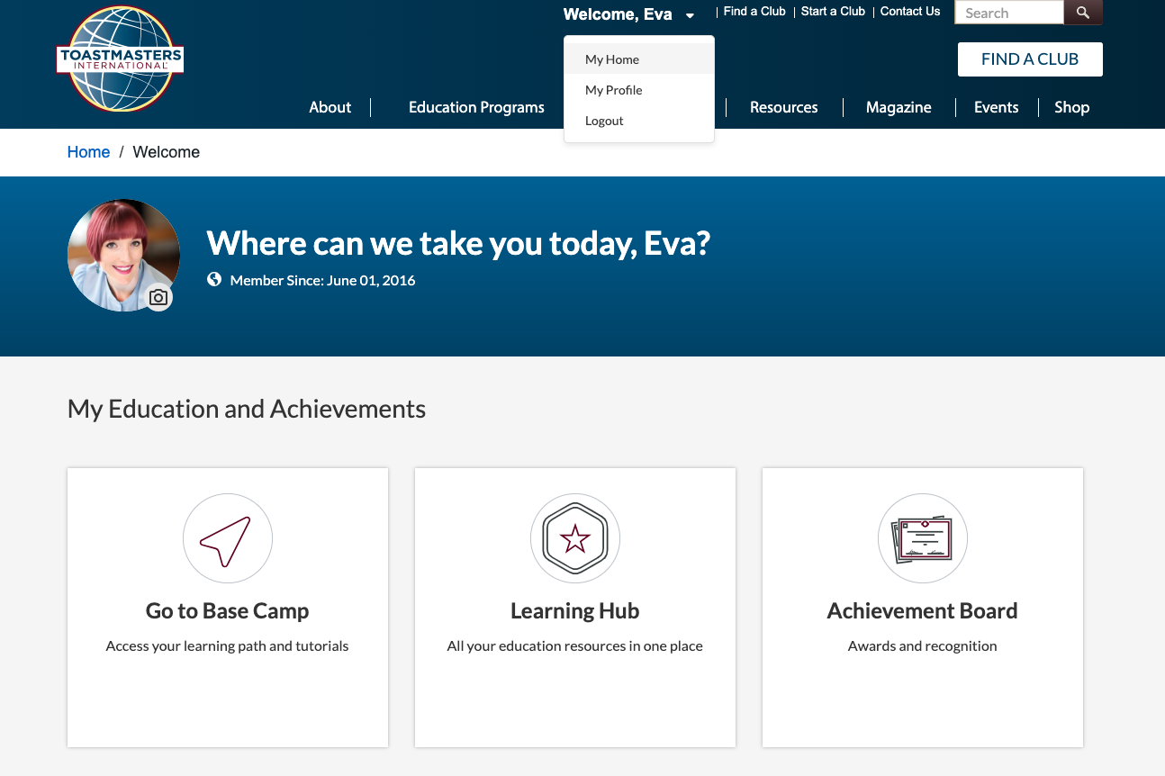
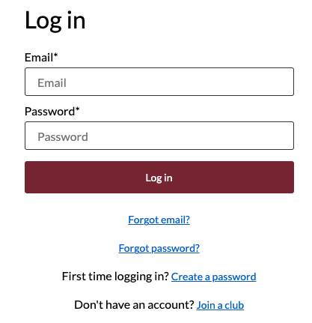
How to Access Base Camp
Go to https://www.toastmasters.org and log in using your email address and password
  If this is the first time you are logging in, click “Create a password” and enter the email you put on your Toastmasters application then create a password
Once you are logged in, click on the the drop down by your name and select “My Home” and click on the card “Go to Base Camp”

Slide 24
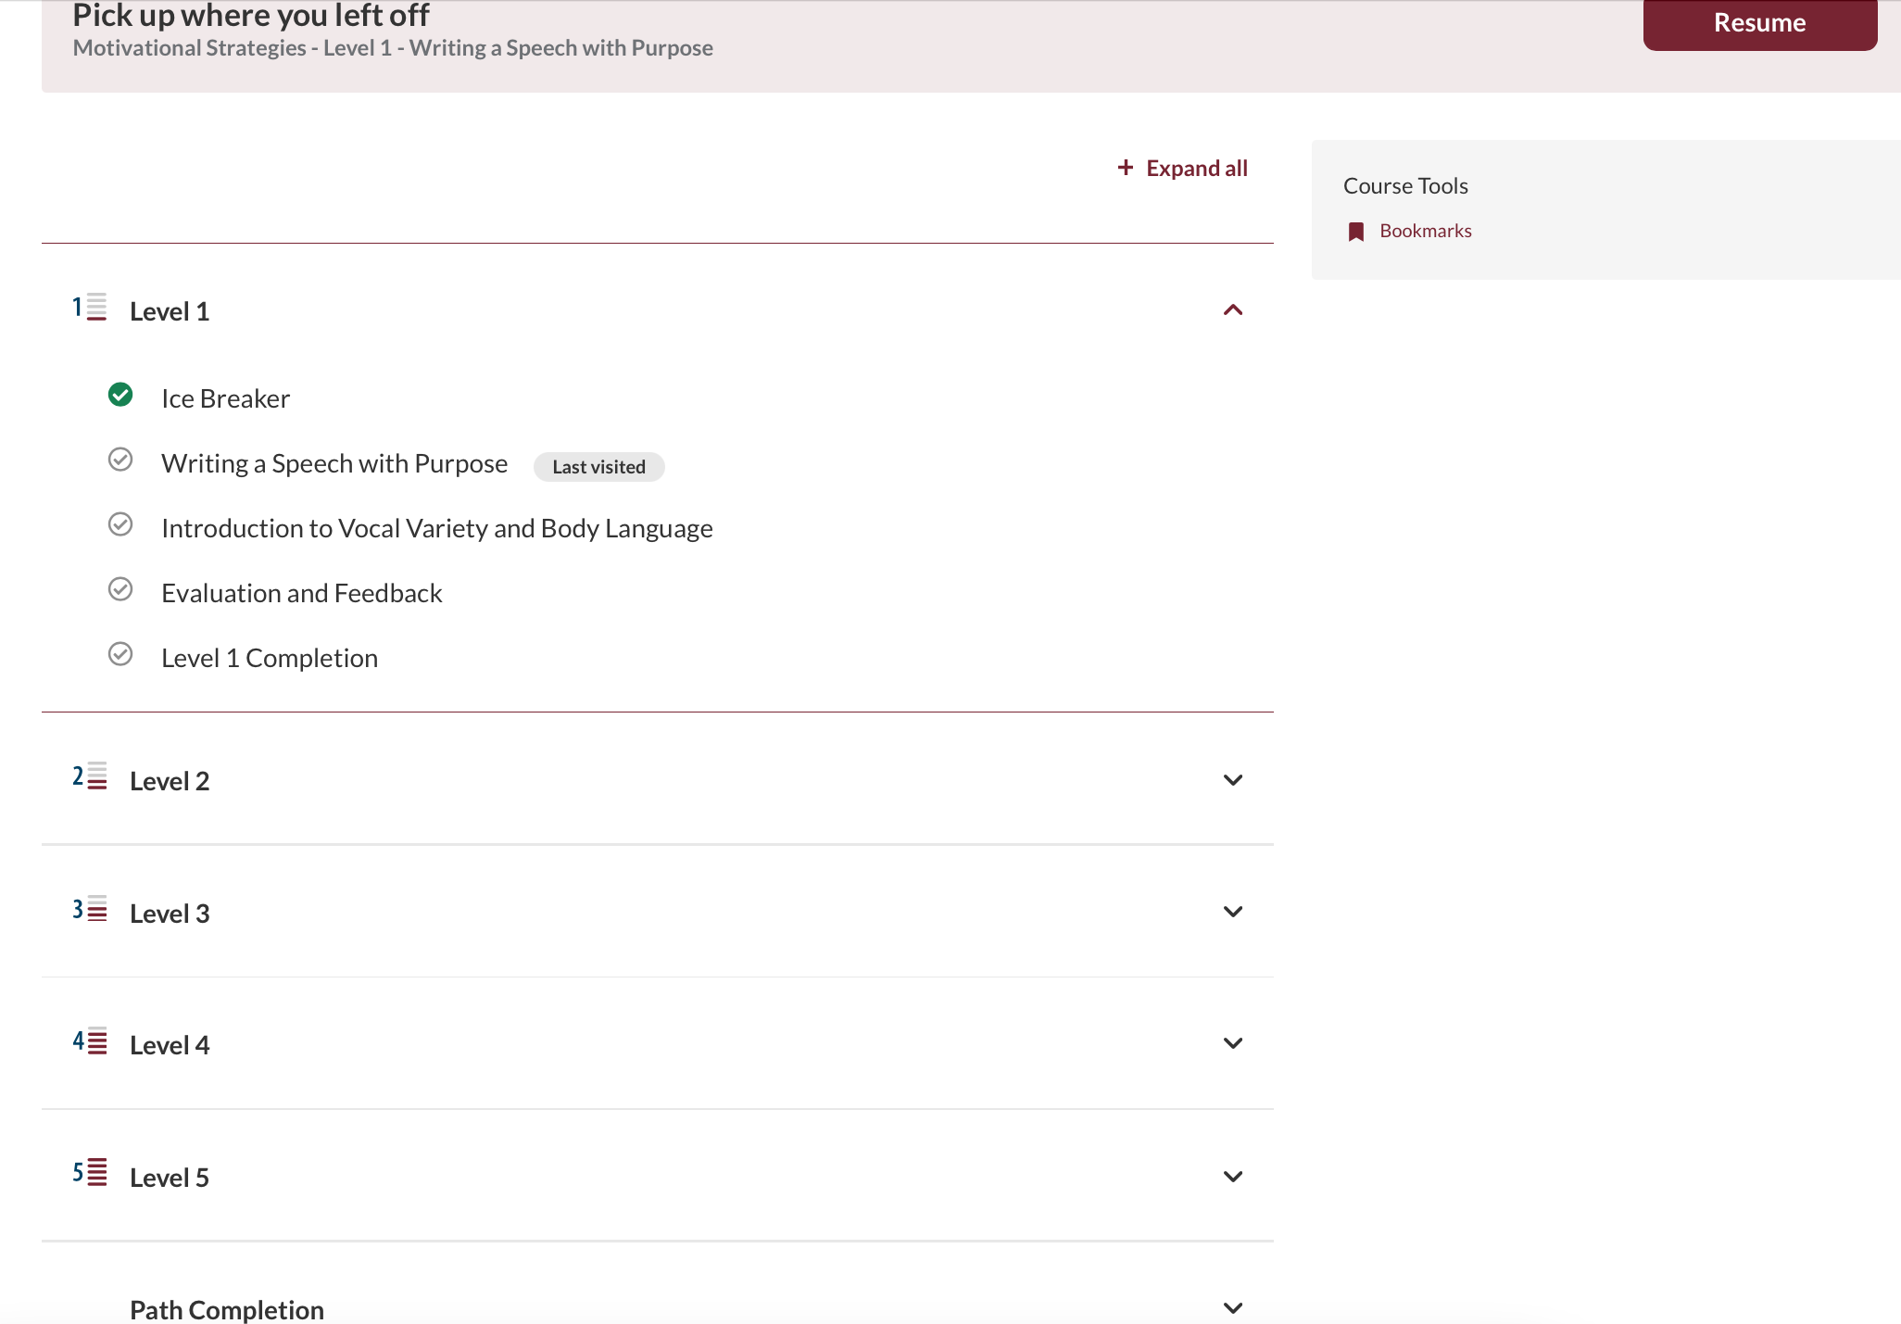
Opening Your Path - Overview

Slide 25
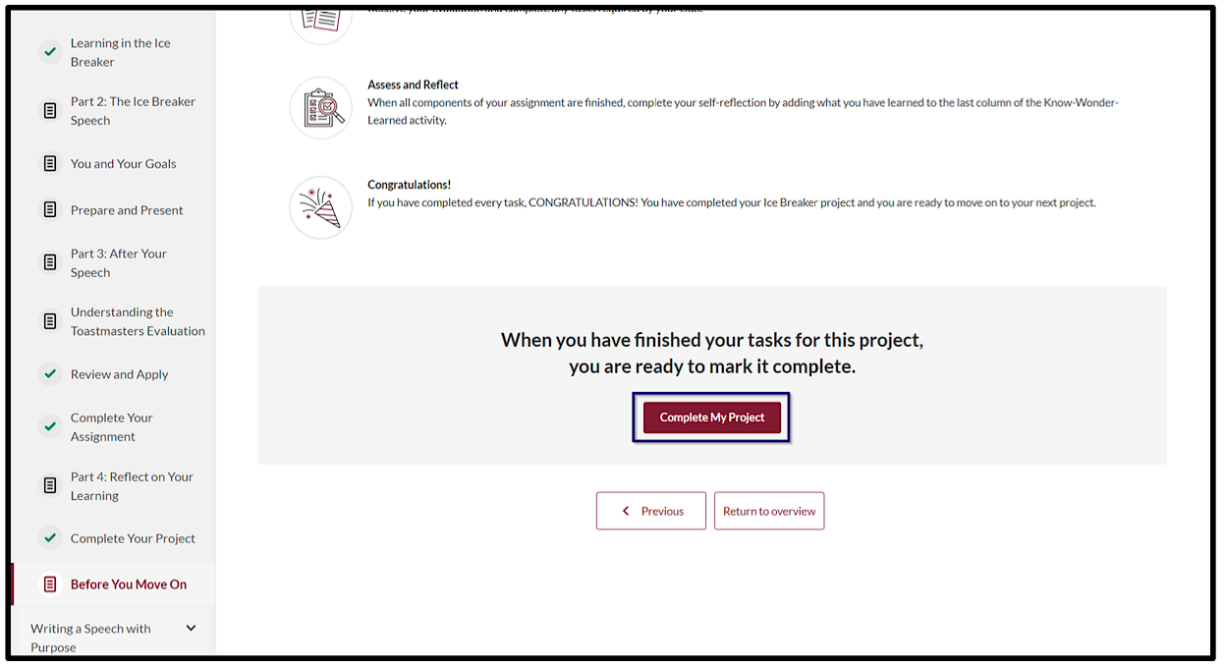
Completing a Project – Mark Complete

Slide 26
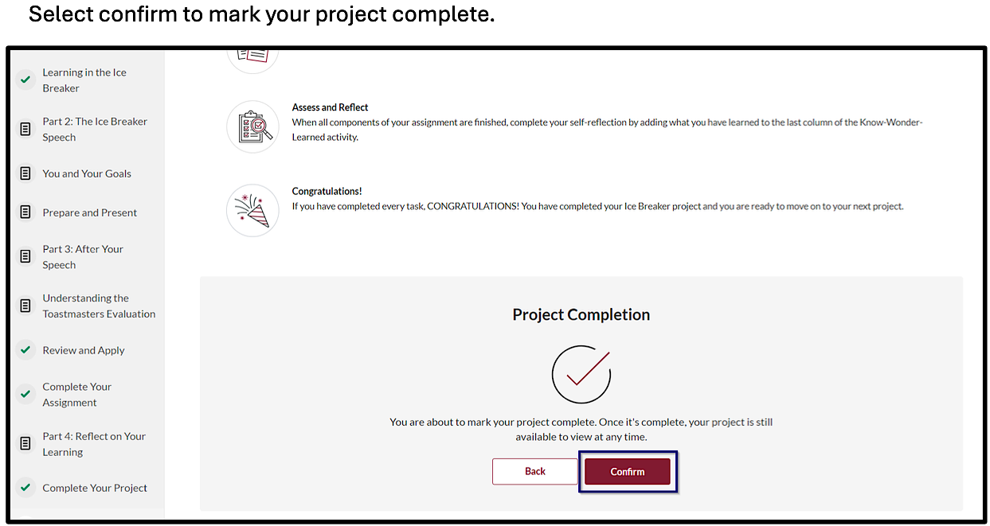
Completing a Project – Mark Complete

Slide 27
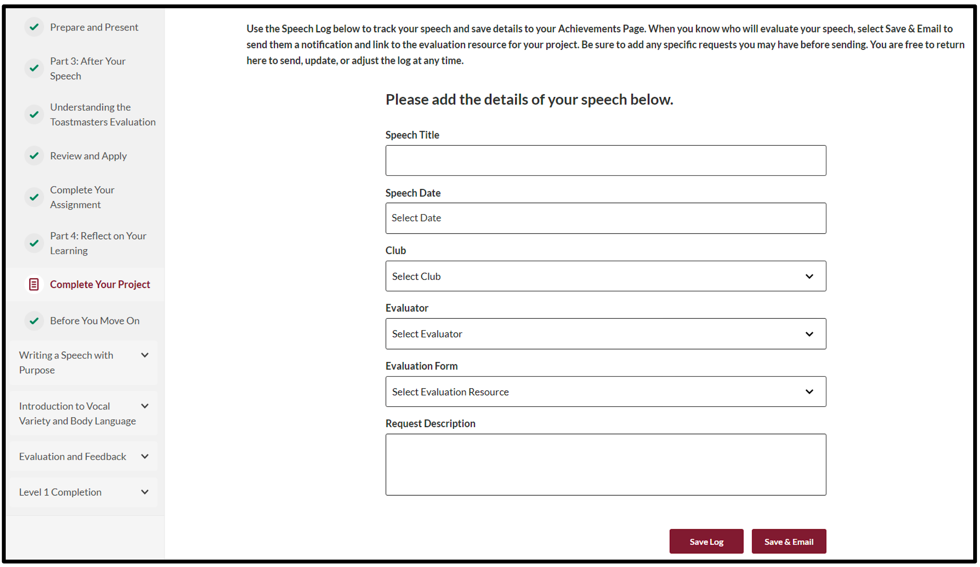
Completing a Speech Log – Within the Project

Slide 28
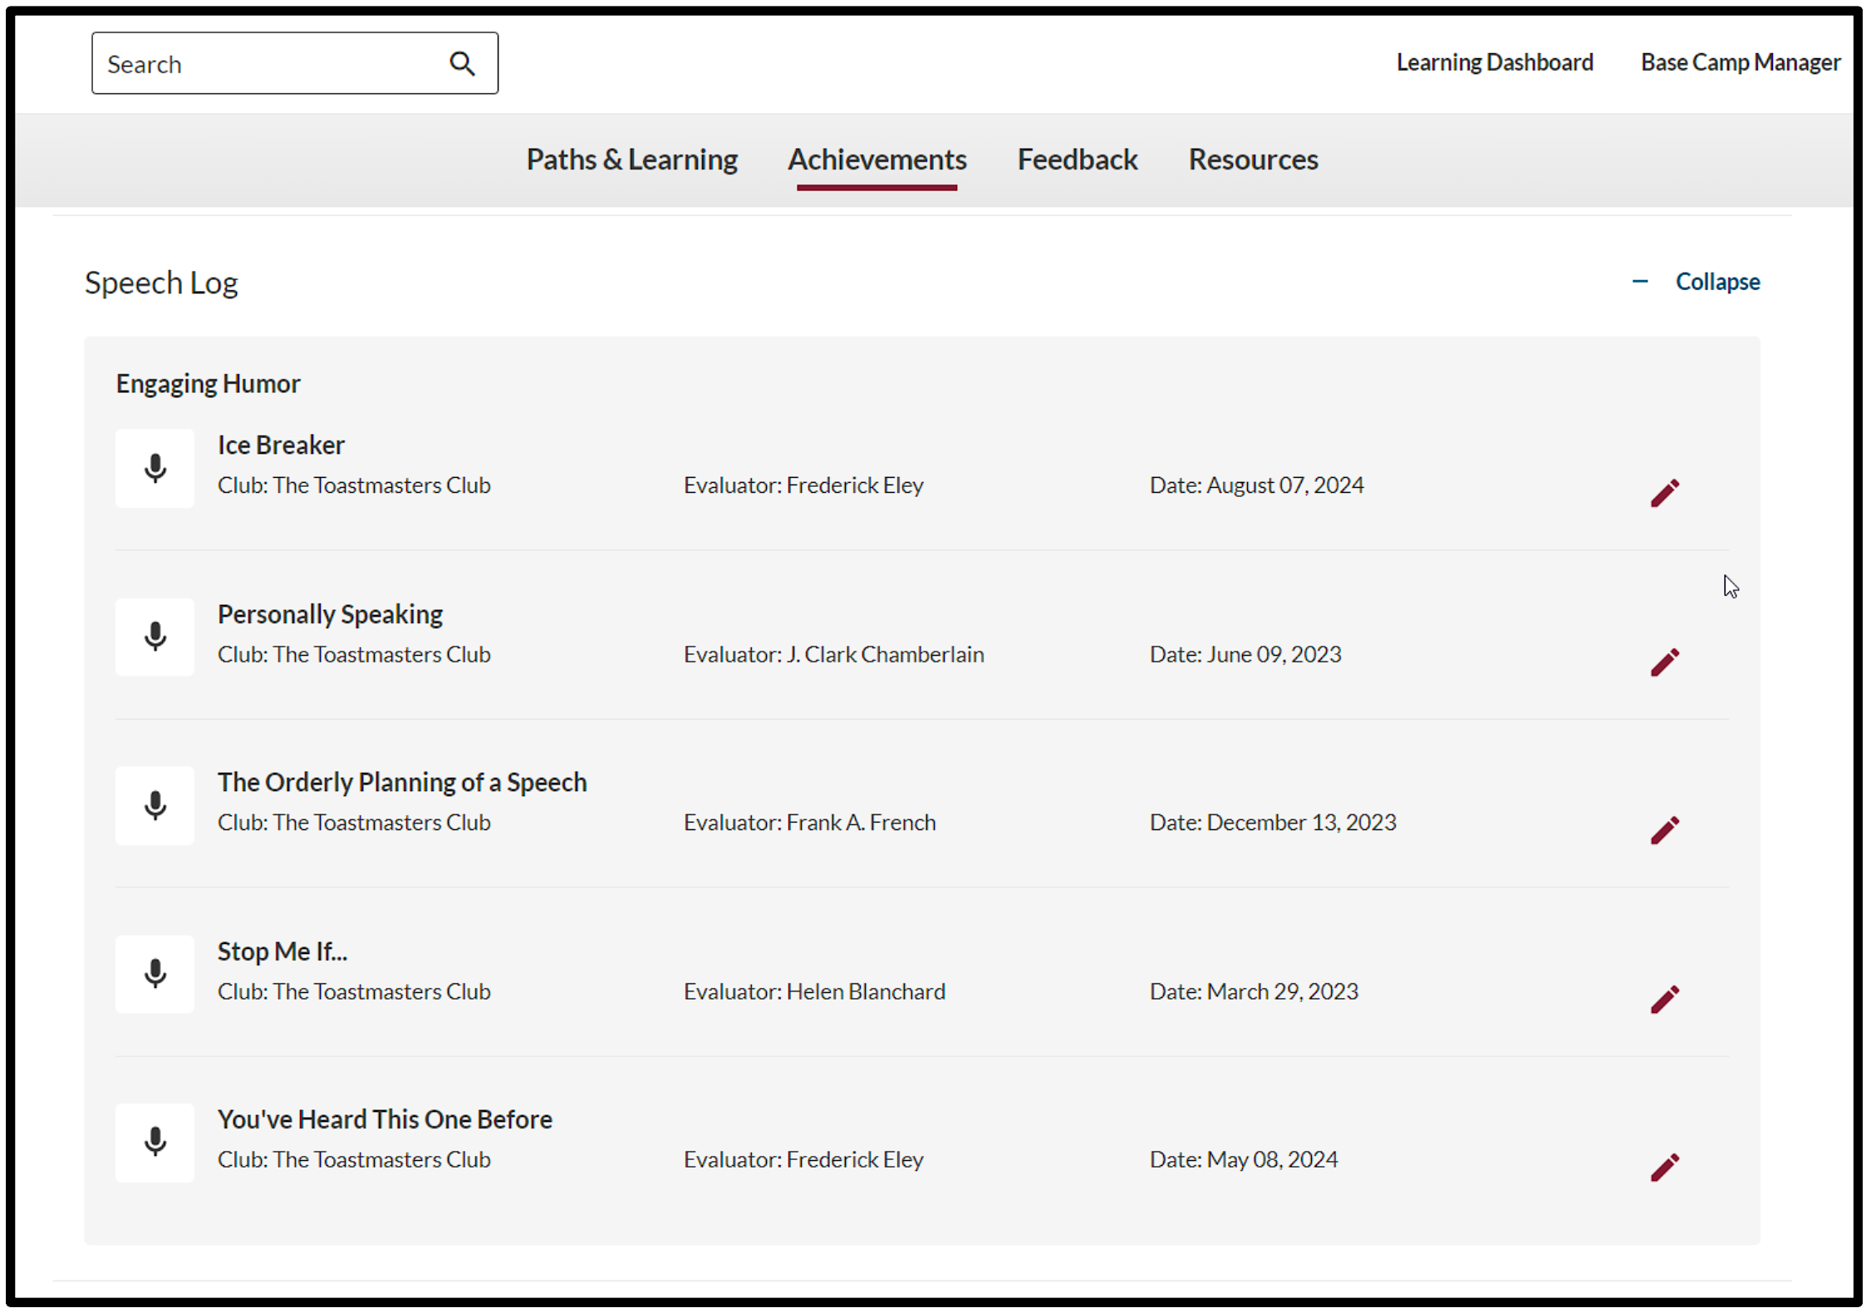
Speech Log

Slide 29
Evaluations – Requesting via Speech Log

Slide 30
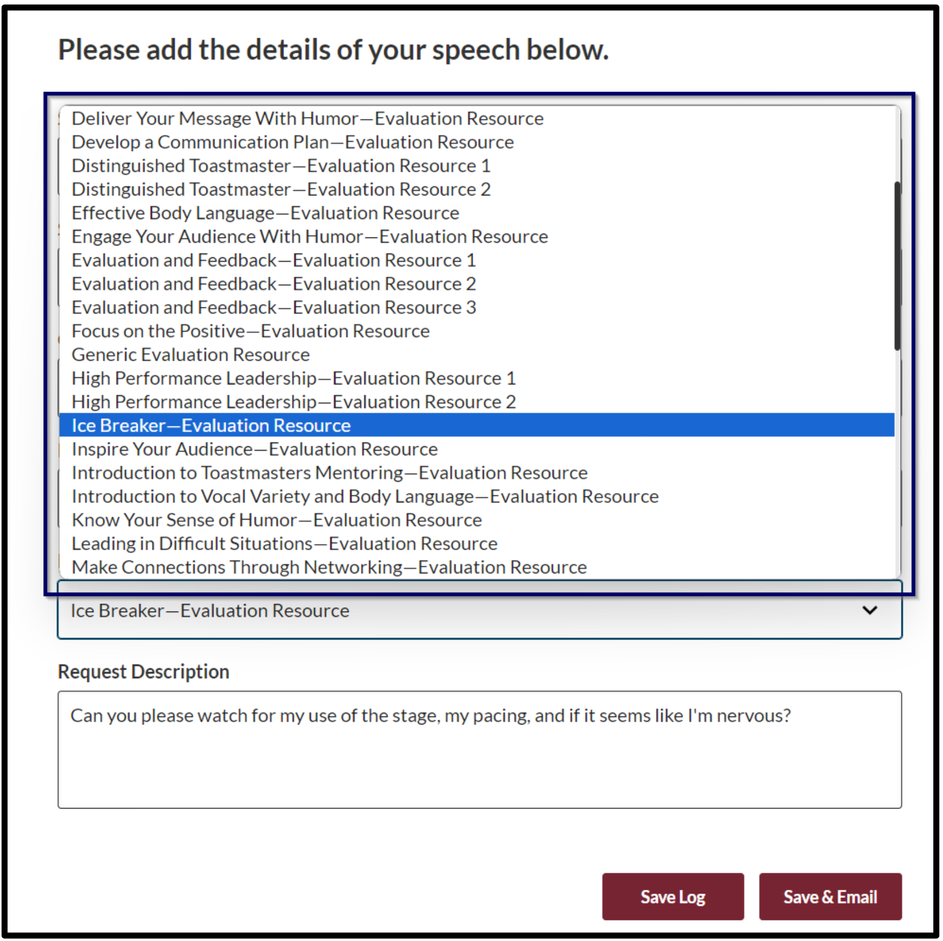
Evaluations – Requesting via Speech Log

Slide 31
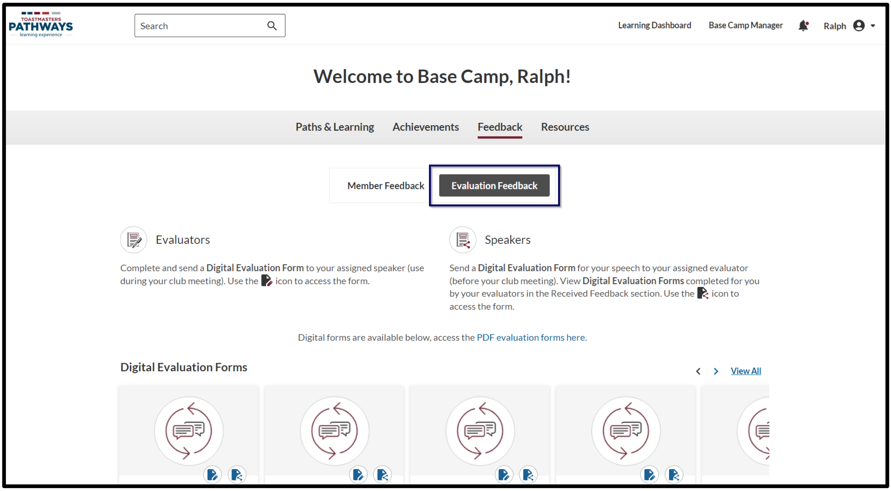
Evaluations – Requesting via Feedback Section
Notes:
This is how you send someone the evaluation form for your speech so they can fill it out using the Feedback section of Base Camp.

Slide 32
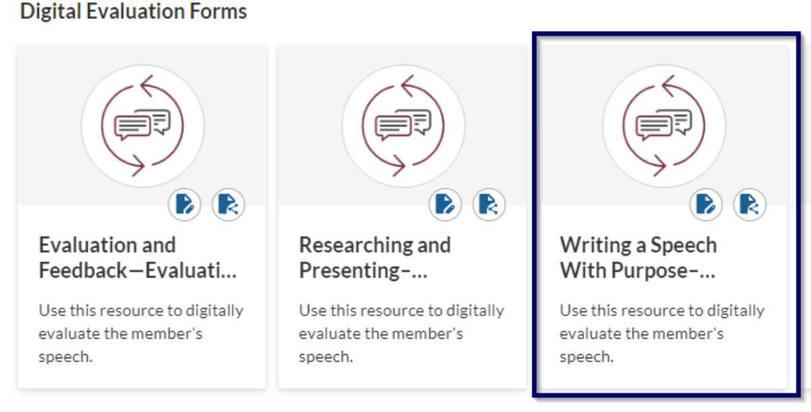
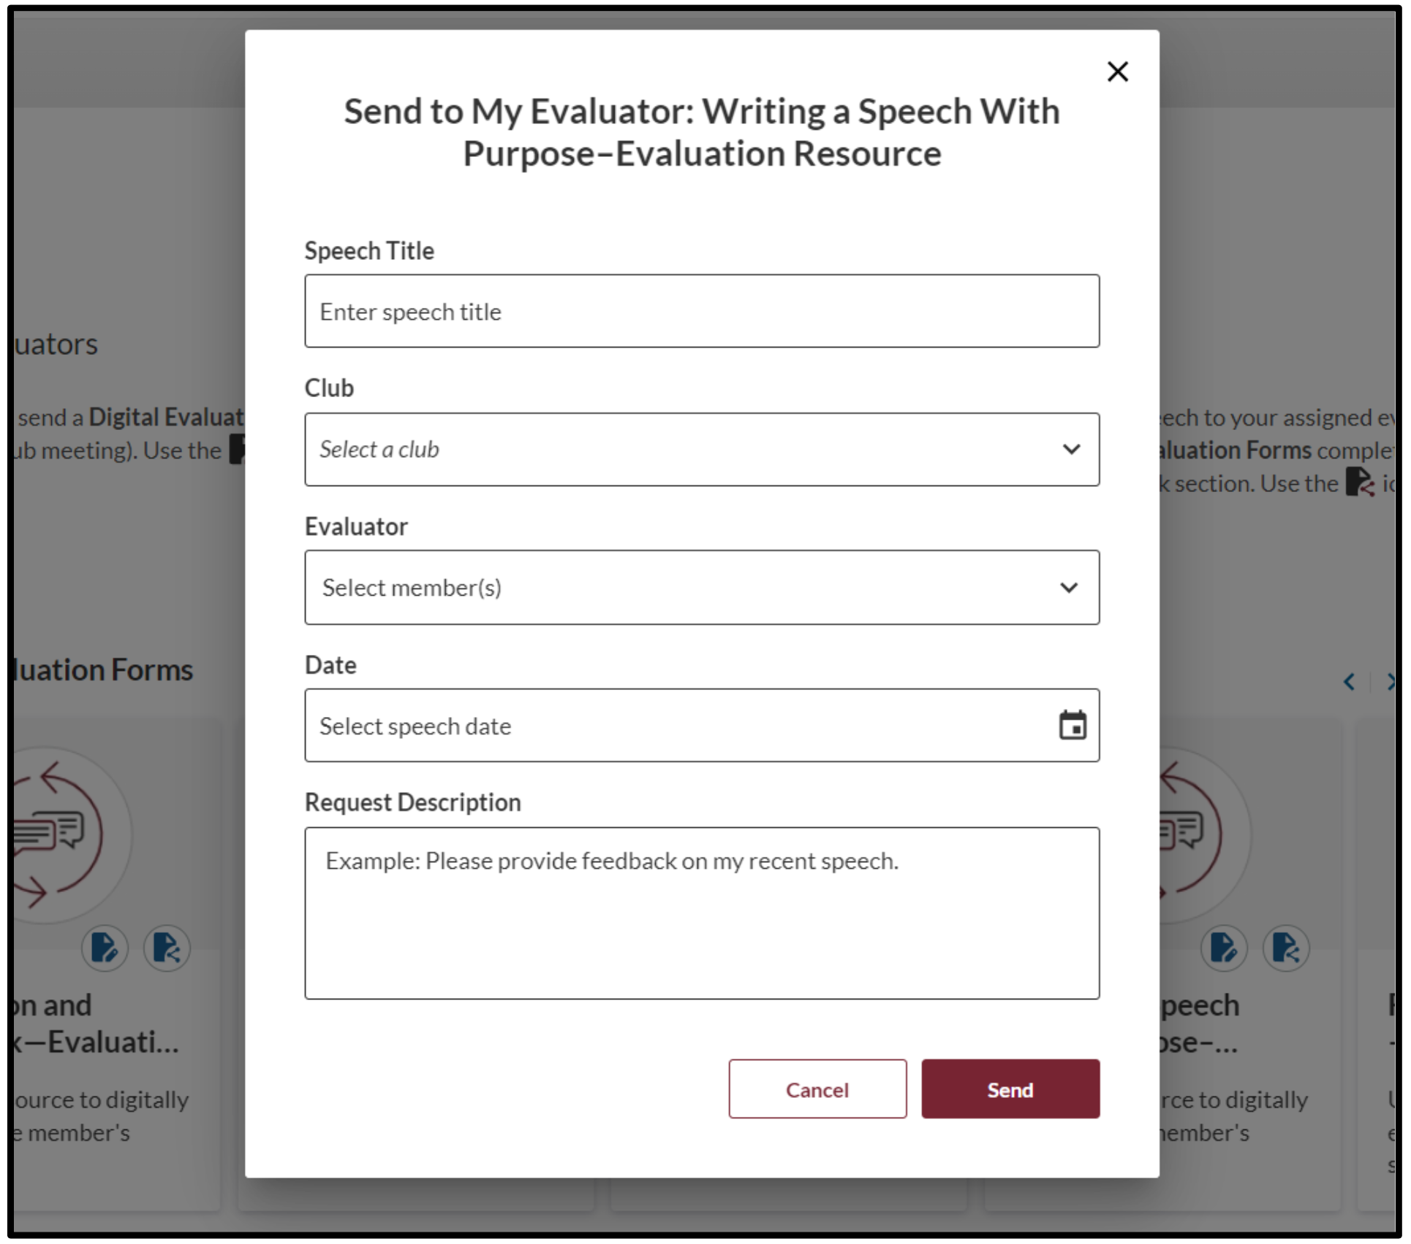

Evaluations – Requesting via Feedback Section
Notes:
This is how you send someone the evaluation form for your speech so they can fill it out using the Feedback section of Base Camp.

Slide 33
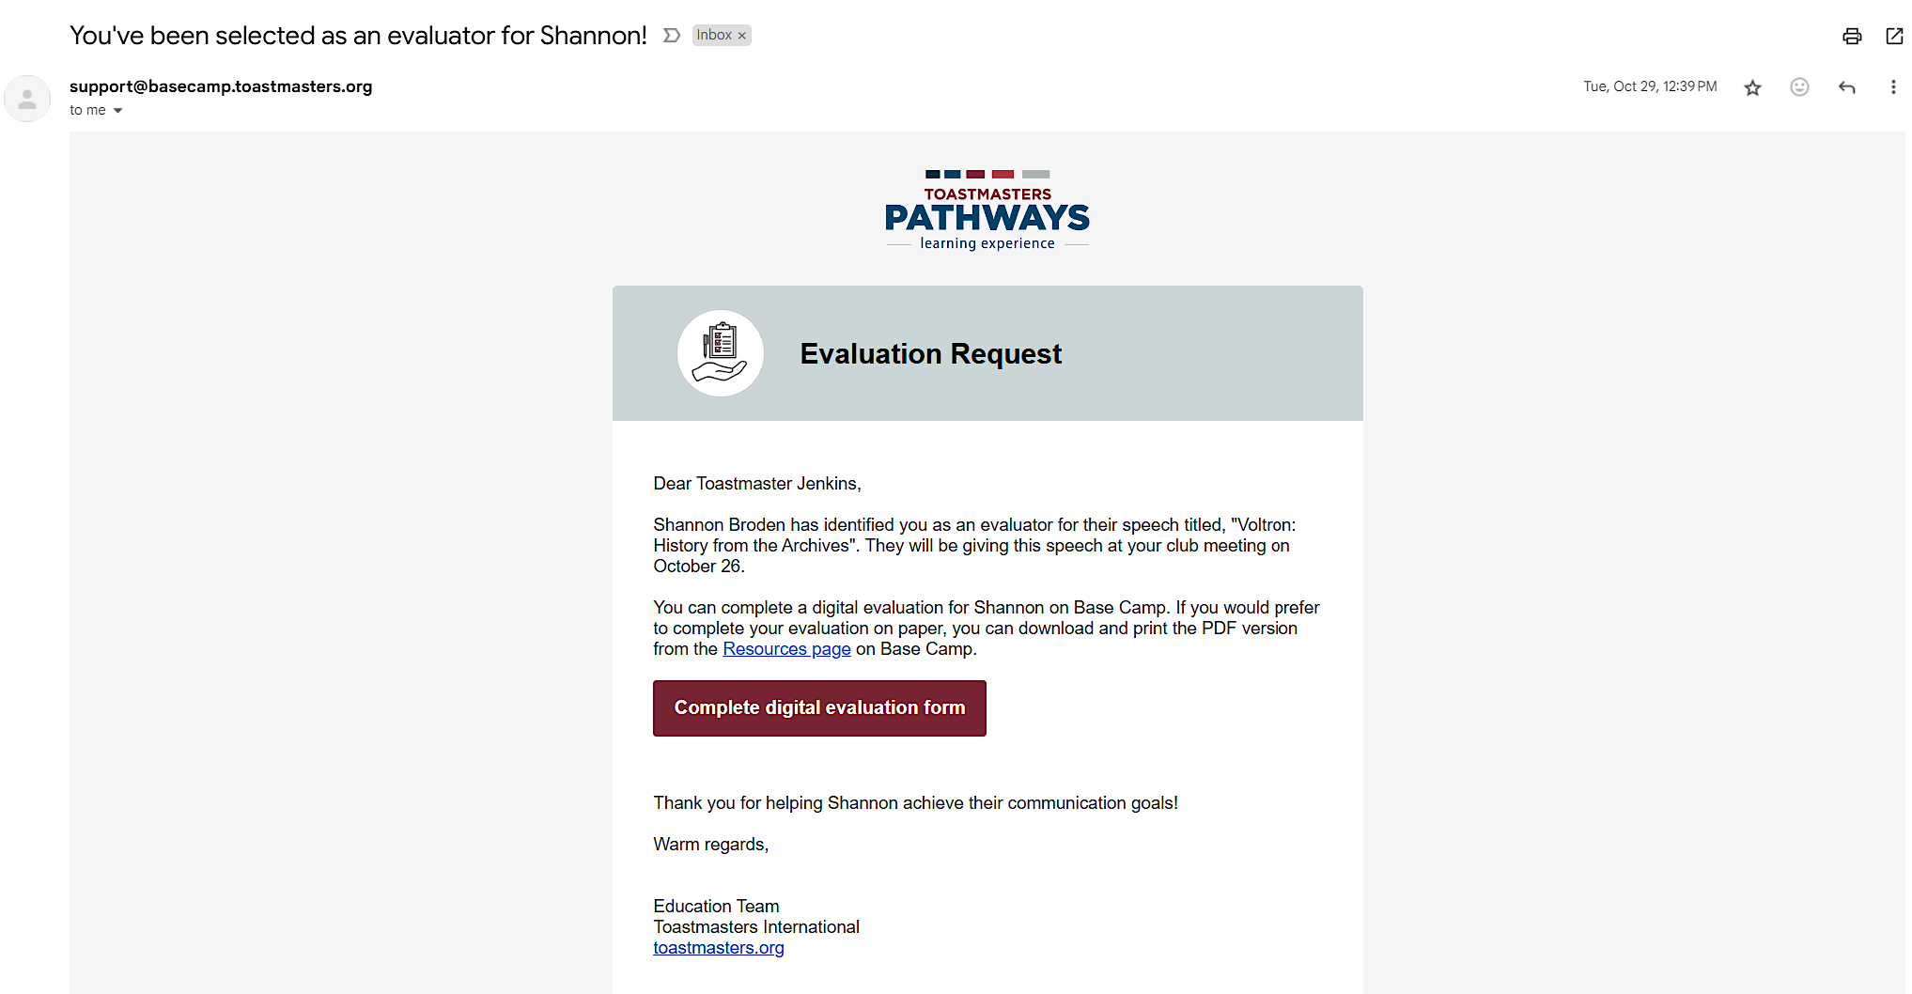
Evaluations – Request Notification Email

Slide 34
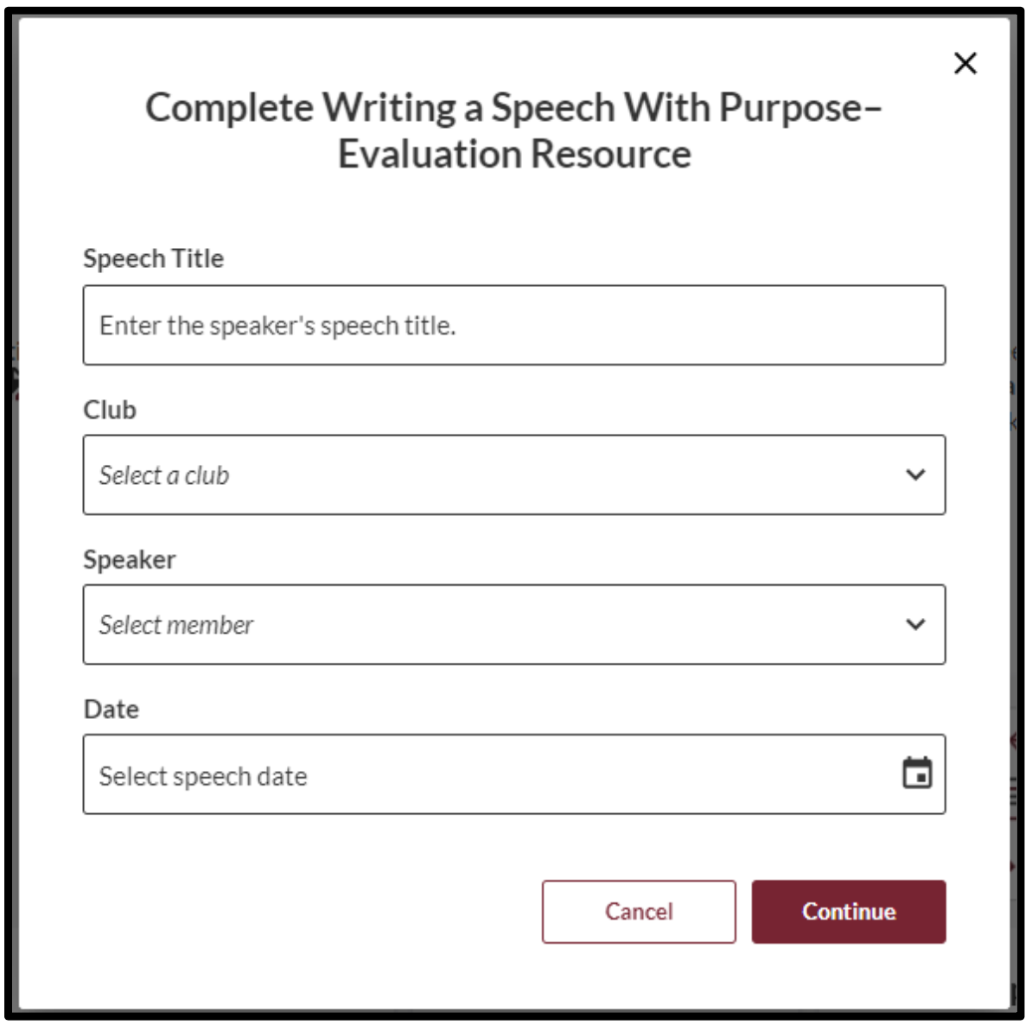

Evaluations – Providing Eval via Feedback Section
Notes:
This is how you fill out and send a speech evaluation form to a member of your club (if they did not send you a request)

Slide 35
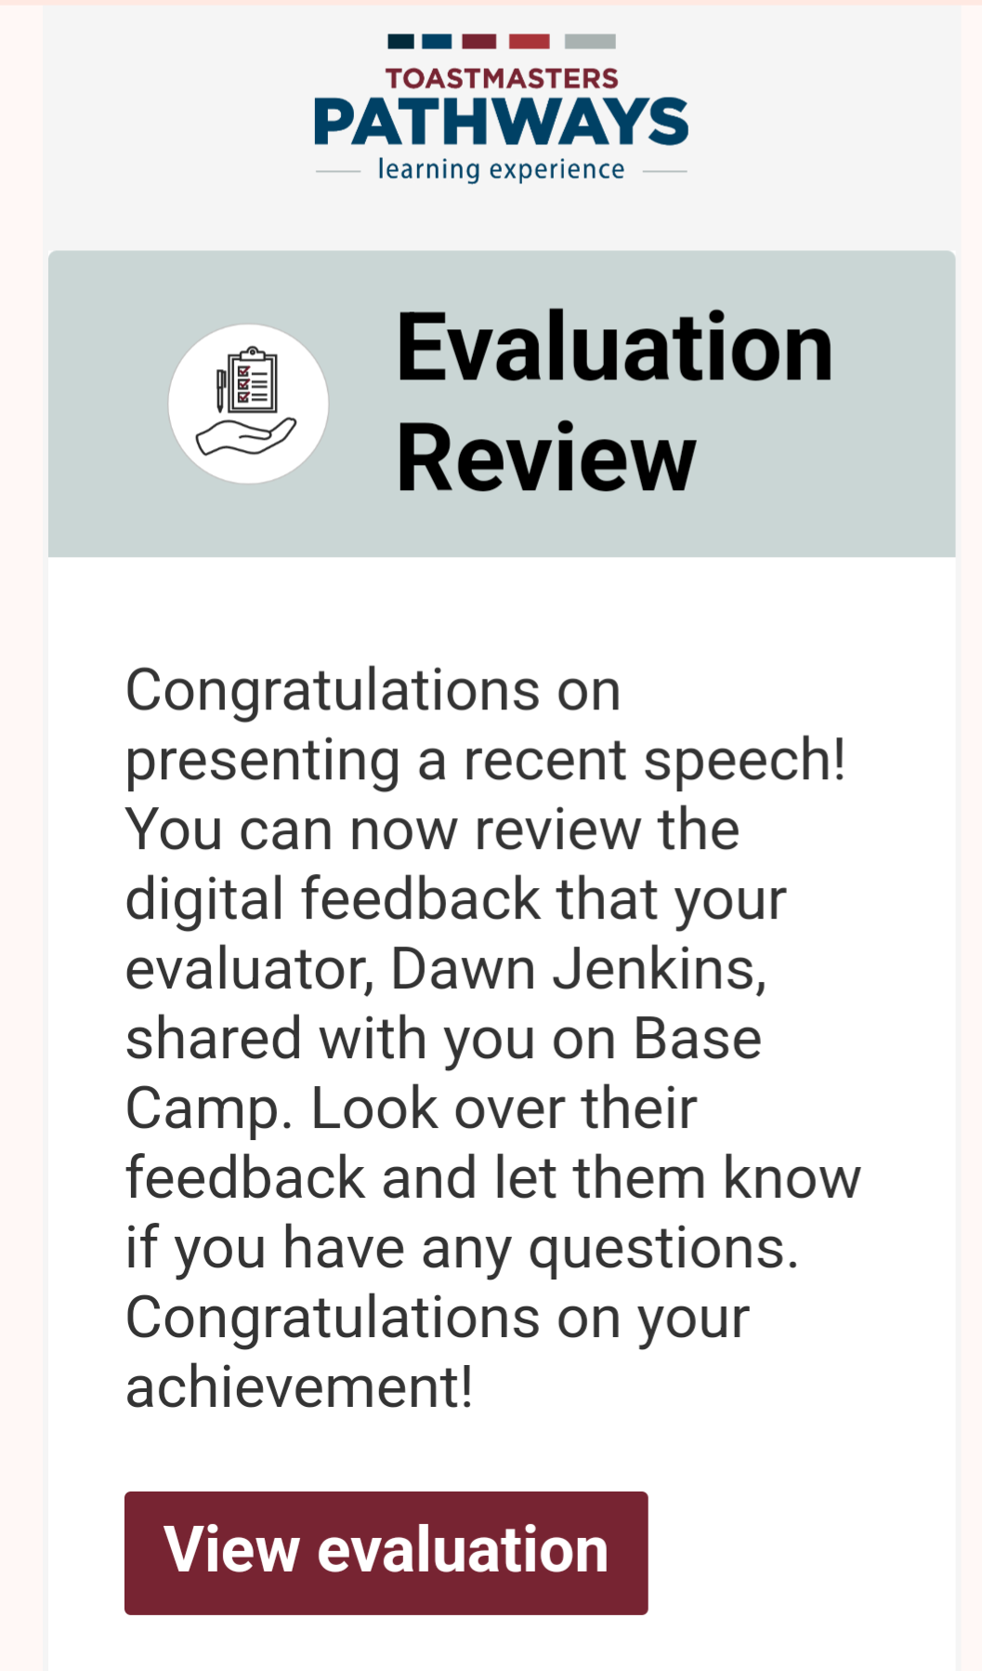
Evaluations – Finding Your Received Evaluation
Once your evaluator has filled out the form, you should receive an email notification with a link to view your evaluation
  If you don’t get it, check your spam folder & your communication permissions on Toastmasters.org under your profile “My Privacy & Consents”
You can also access your evaluation forms sent to you by your evaluators online on Base Camp

Slide 36
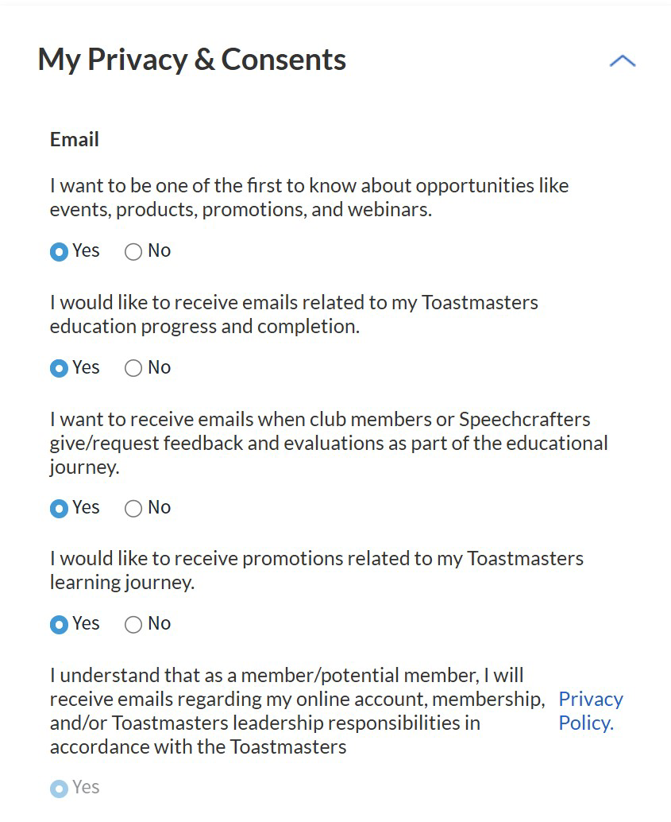
Enable Notification Emails
Make sure you have this option selected as “Yes” or you will NOT get any emails with evaluation requests or with completed forms from your evaluators

Slide 37
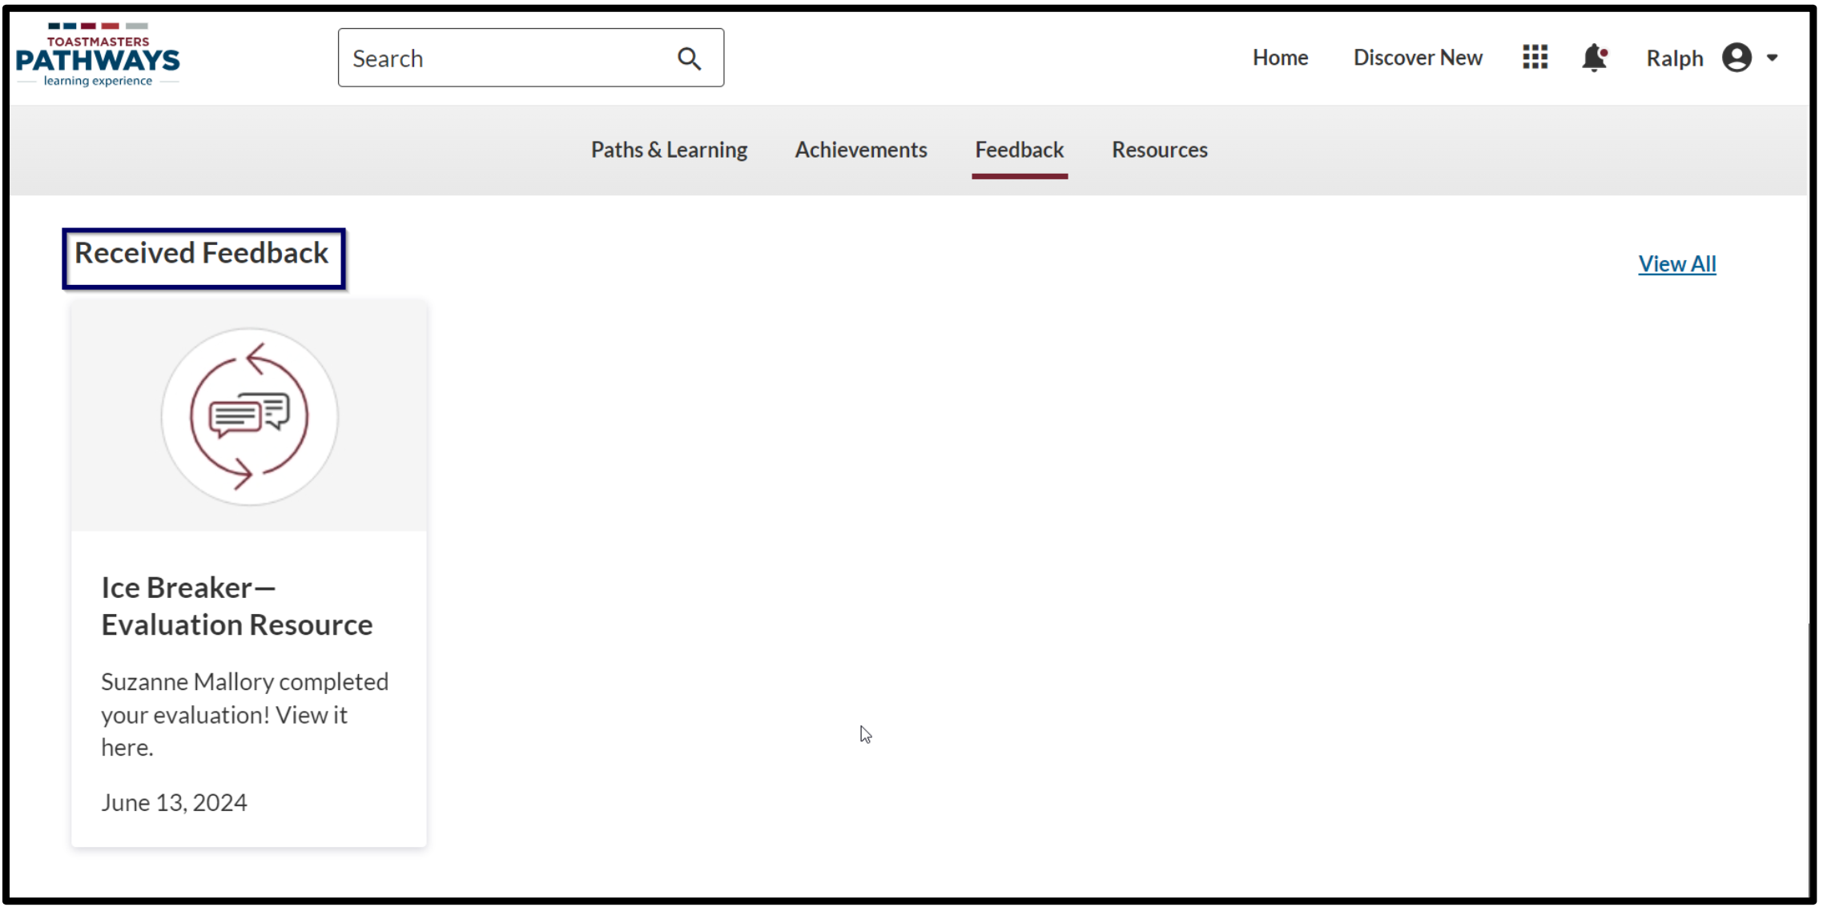
Evaluations – Finding Your Received Evaluation
Find your evaluation forms sent to you by your evaluators on Base Camp

Slide 38
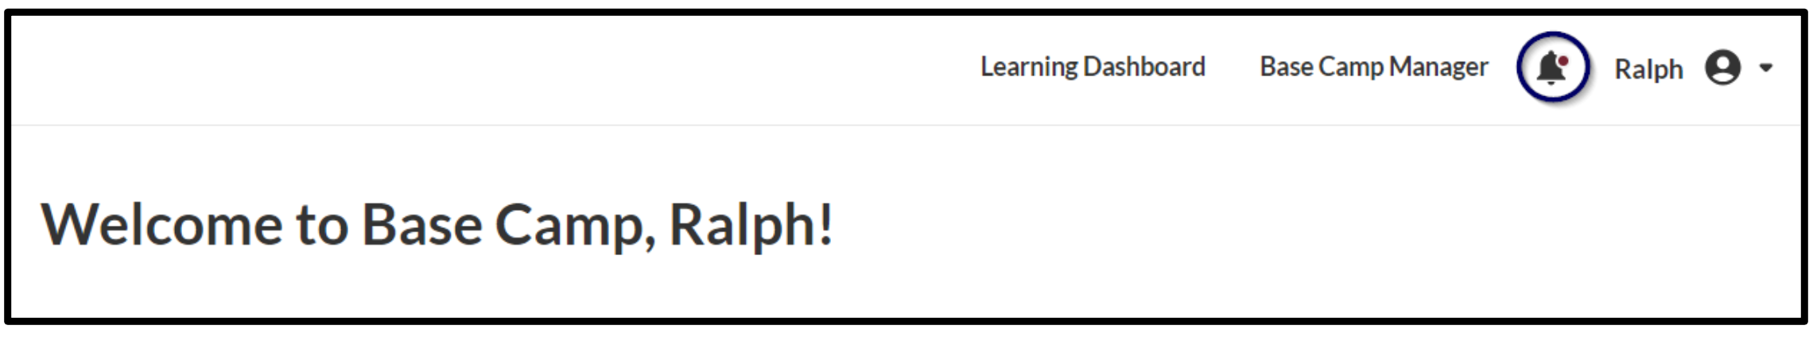
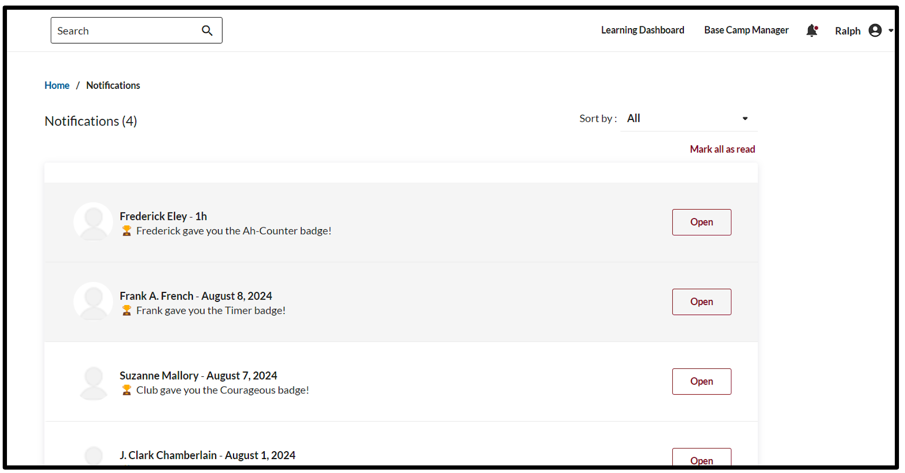
Evaluations – Finding Your Received Evaluation

Slide 39
More Advanced Base Camp Tutorials

Slide 40
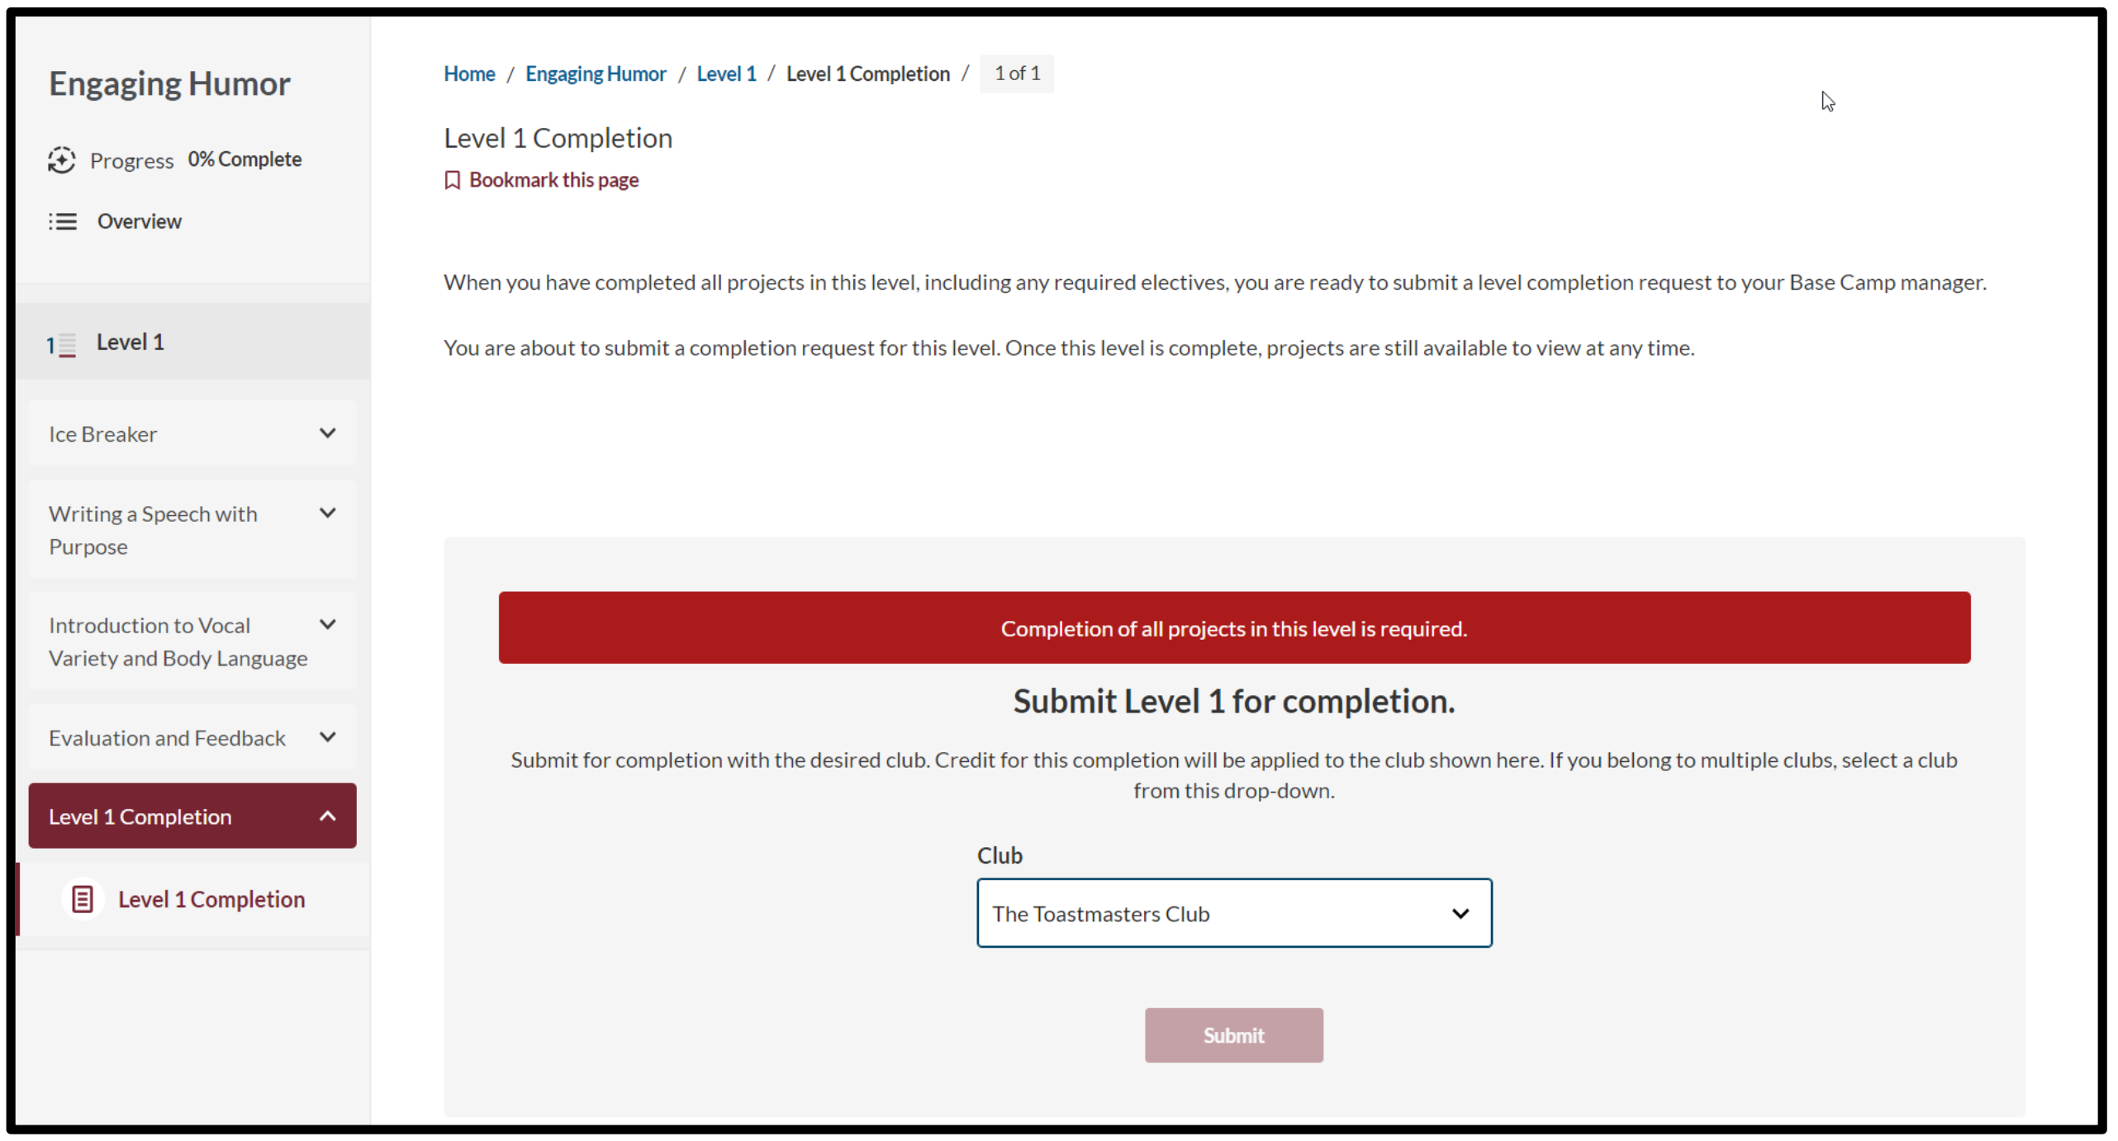
Completing a Level – Select Correct Club

Slide 41
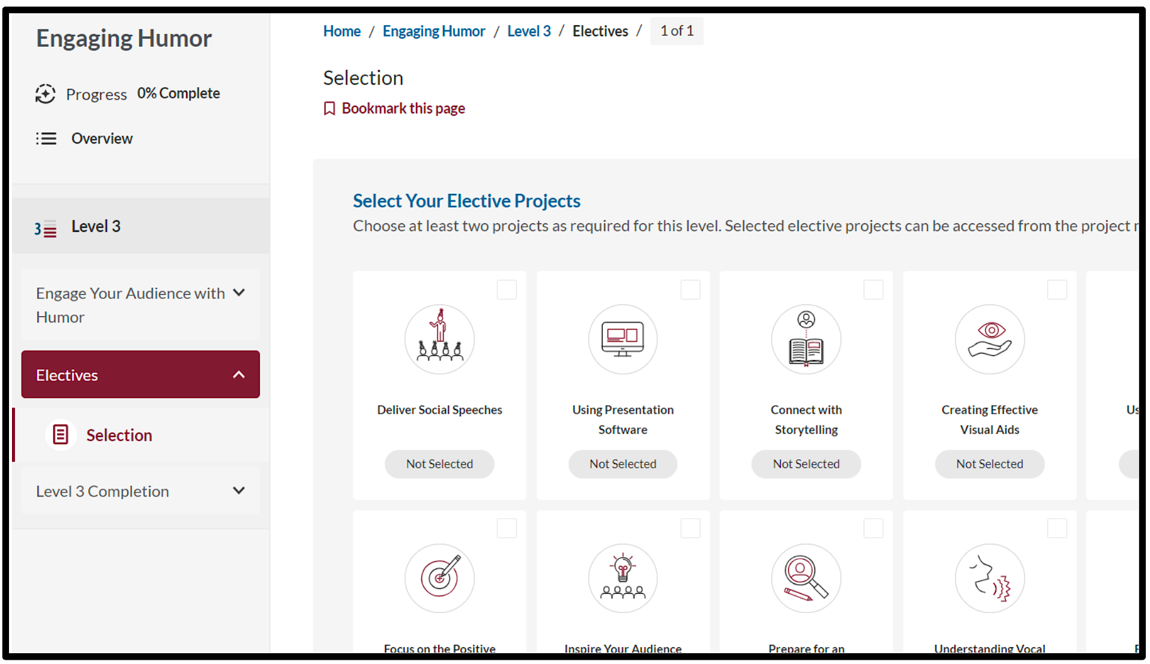
Electives – View Options

Slide 42
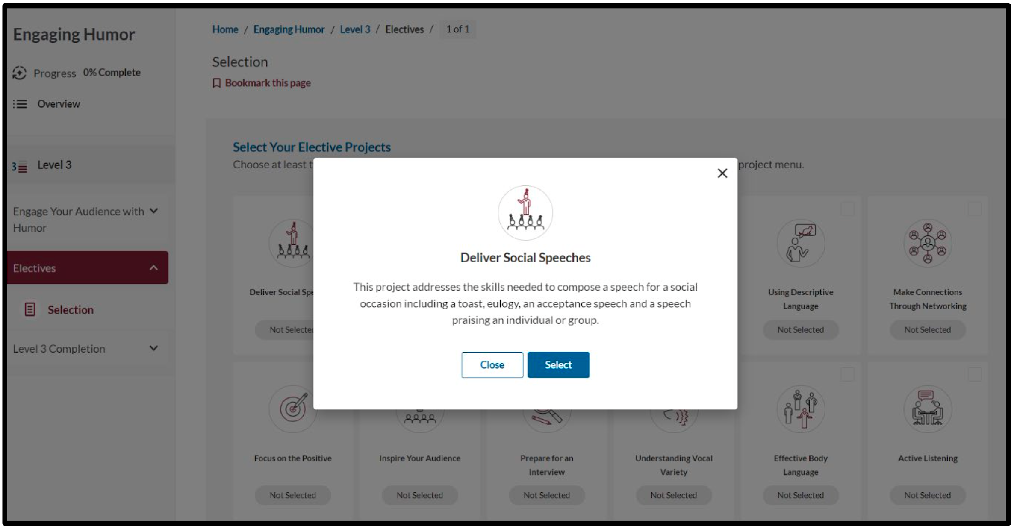
Electives – Select Desired Elective

Slide 43
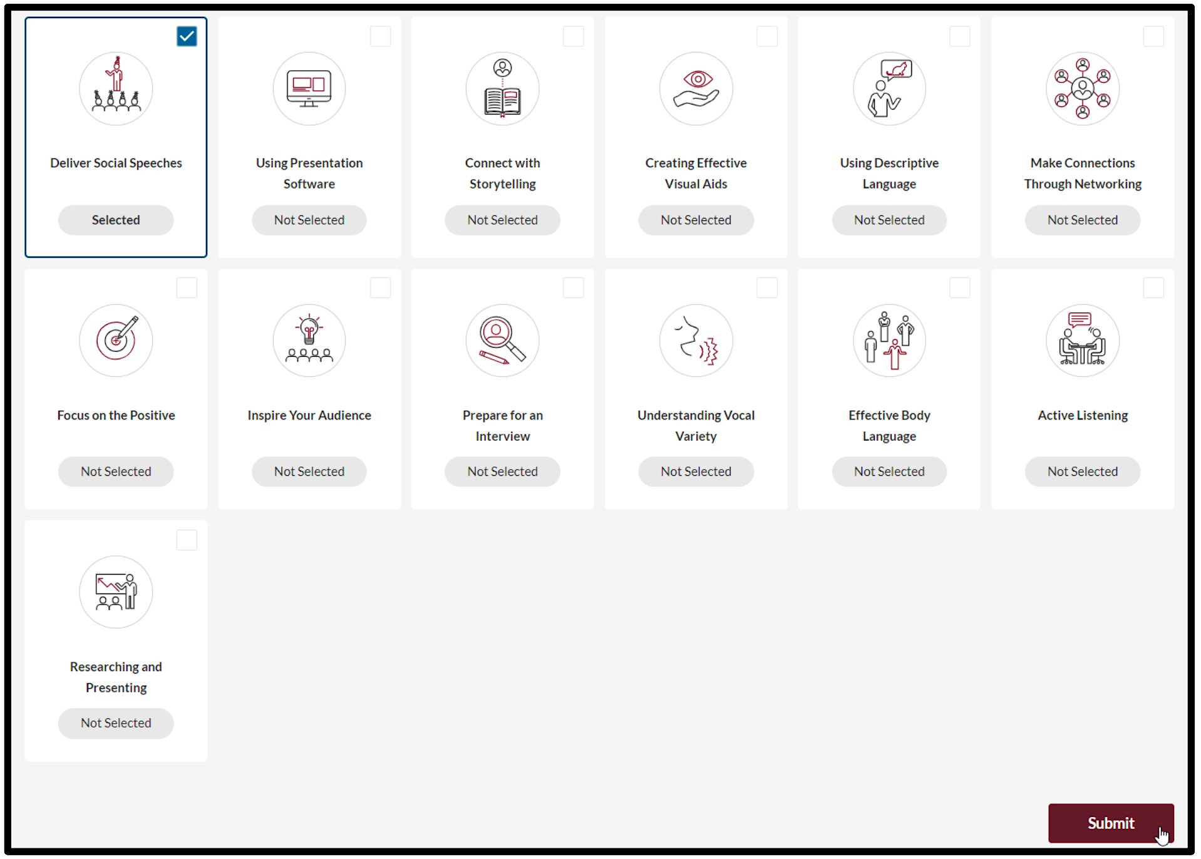
Electives – Select Desired Elective

Slide 44
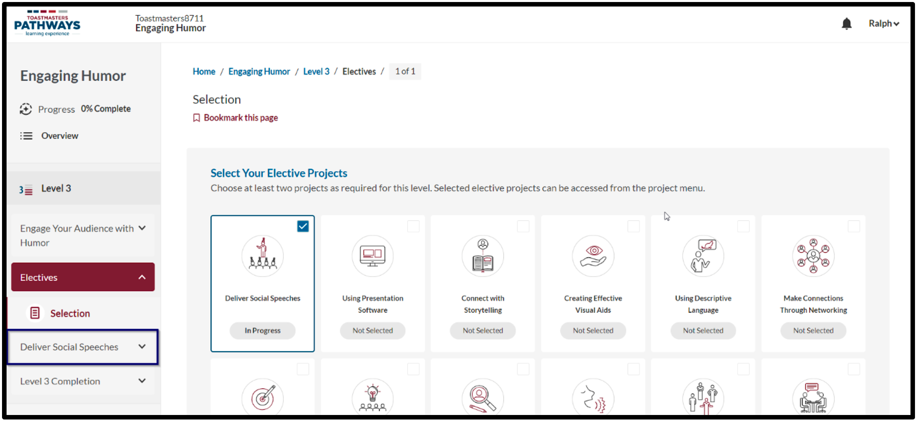
Electives – Select Desired Elective

Slide 45
Base Camp Manager Tutorials

