Slide 1
October 2025 Updates
The new member fee increased to $25 USD on October 1, 2025
Two new Pathways enhancements
  Role & Presentation Requirements (late October)
    The new meeting role and presentation requirements are in addition to the other required projects at each level of a path
    The current required projects will not change or be switched out for these new ones
    A new section will be added as the first item in each level, before the projects
  Two Vintage Path Additions (2026)
    One path will be Ralph Smedley’s original Basic Training Manual with it’s original vintage look
    The other Path will consist of the Competent Communication manual and two Advanced Communication manuals
https://www.toastmasters.org/magazine/magazine-issues/2025/october/pathways-additions-arrive

Slide 2
Pathways Overview
Eva Tweedy, DTM

Slide 3
What is Pathways?
The Pathways learning experience is a self-paced, interactive, and flexible education program. It was created to help you strengthen your communication and leadership skills and grow toward personal & professional success, all while having fun!
Definitions:
Pathways = the self paced education program
Path = the specialized path (learning module) you choose to follow
Base Camp = the online interface/e-learning platform we use to access the program
Toastmasters.org = Toastmasters Int’l website where you access Base Camp and your account
TMD55.org = the district website where you can find trainings, resources, and info on local events

Slide 4
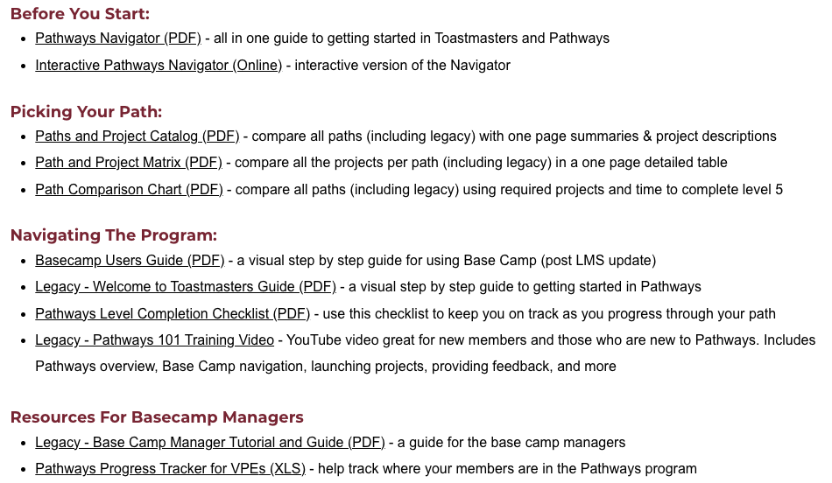
TMD55.org Pathways Resources

Slide 5
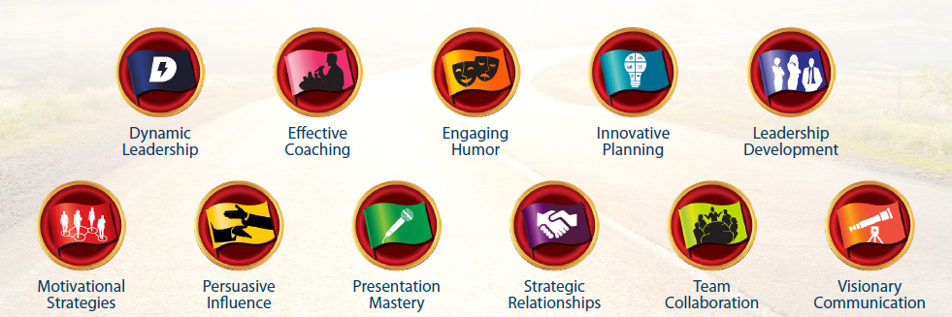
11 Paths (Legacy)

Slide 6
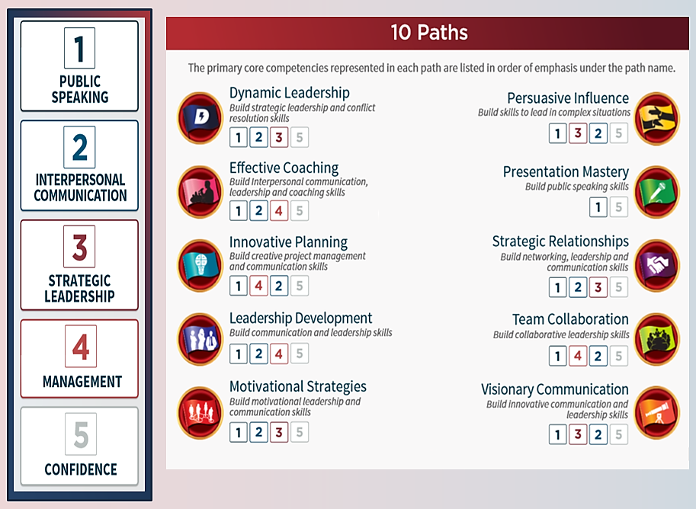
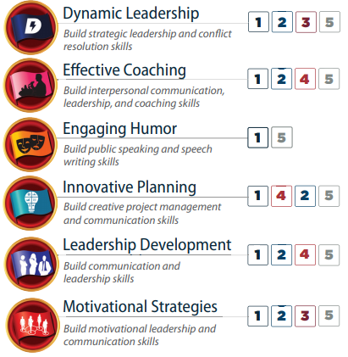
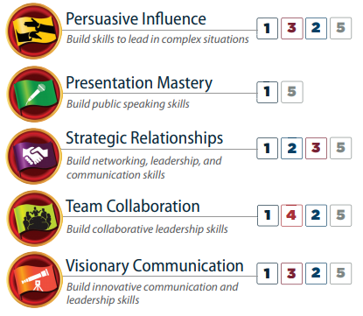






11 Paths
6 Paths
The primary core competencies represented in each path are listed in order of emphasis below.
Pathways Mentoring Program
Notes:
upcoming Pathways changes [emails.toastmasters.org]. You may remember that in March we announced that Base Camp, the online system where Pathways is accessed, is moving to a new learning management system (LMS) early next year.
The new LMS will launch with six paths:
Dynamic Leadership
Engaging Humor
Motivational Strategies
Presentation Mastery
Persuasive Influence
Visionary Communication
If you start a different path before the new LMS launches next year, you will still be able to access your educational content, complete projects, and receive credit for path and level completions. The content simply won’t look like updated Pathways content.

Slide 7
6 Paths
The primary core competencies represented in each path are listed in order of emphasis below.
Notes:
upcoming Pathways changes [emails.toastmasters.org]. You may remember that in March we announced that Base Camp, the online system where Pathways is accessed, is moving to a new learning management system (LMS) early next year.
The new LMS will launch with six paths:
Dynamic Leadership
Engaging Humor
Motivational Strategies
Presentation Mastery
Persuasive Influence
Visionary Communication
If you start a different path before the new LMS launches next year, you will still be able to access your educational content, complete projects, and receive credit for path and level completions. The content simply won’t look like updated Pathways content.

Slide 8
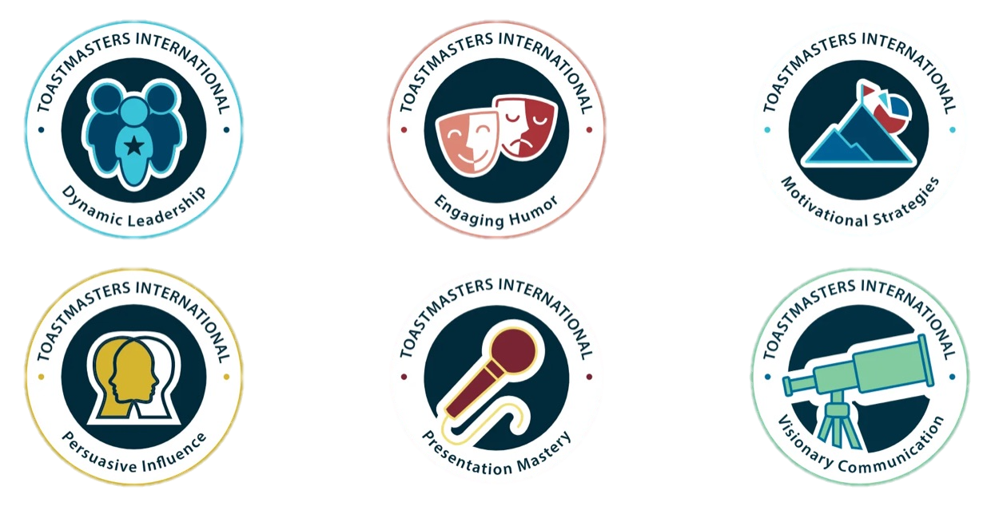
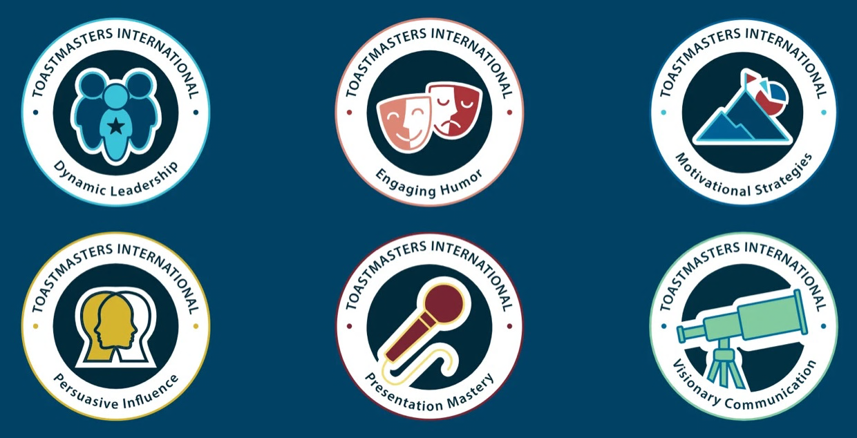
Updated Pathways (simplified to 6 paths)

Slide 9
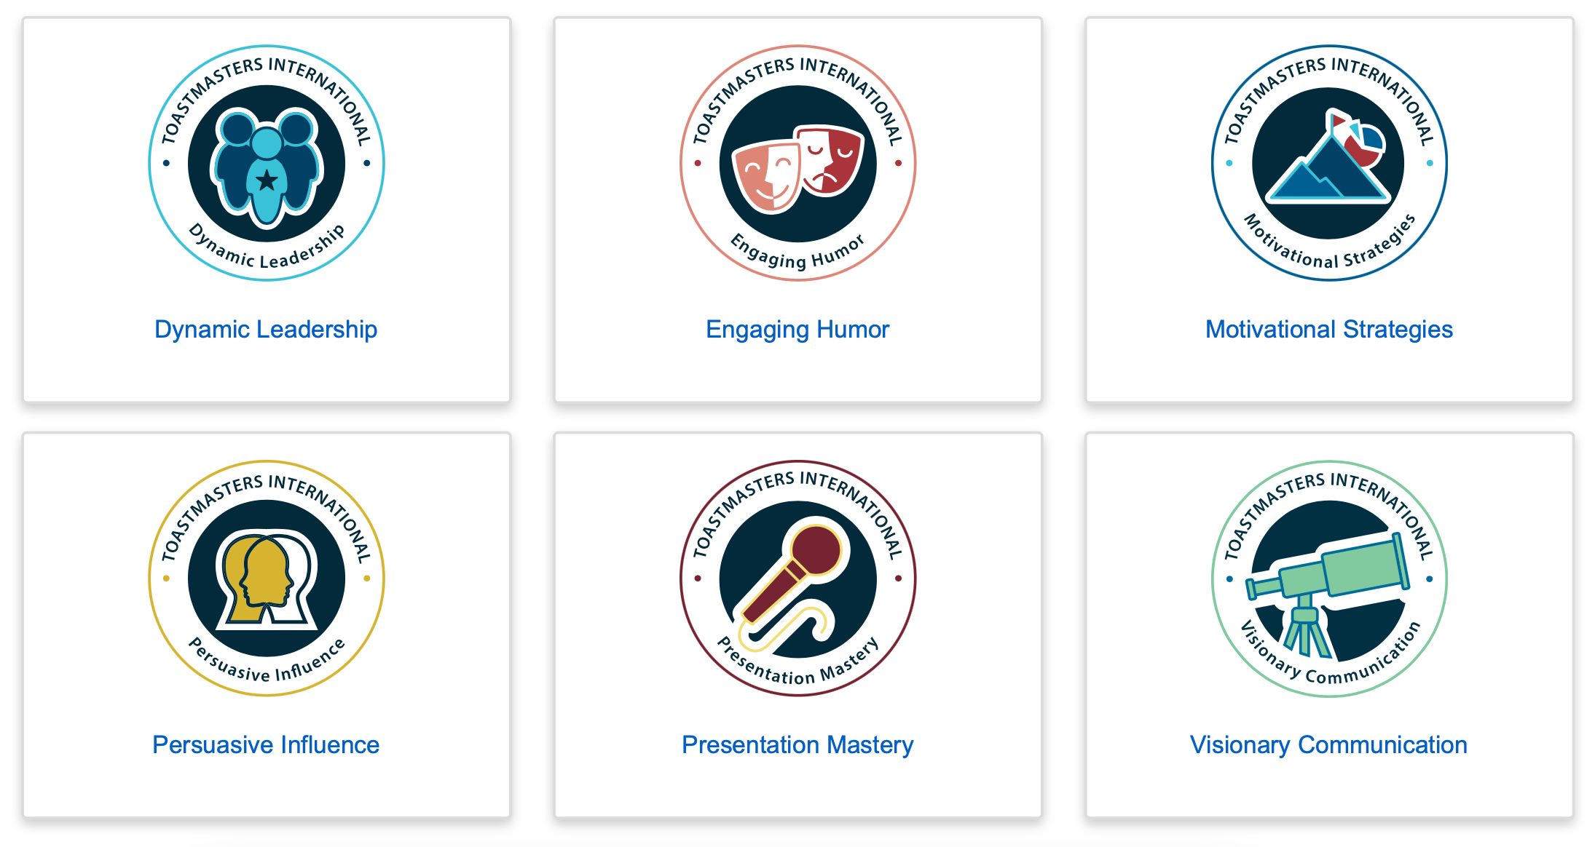
What are the Paths?

Slide 10
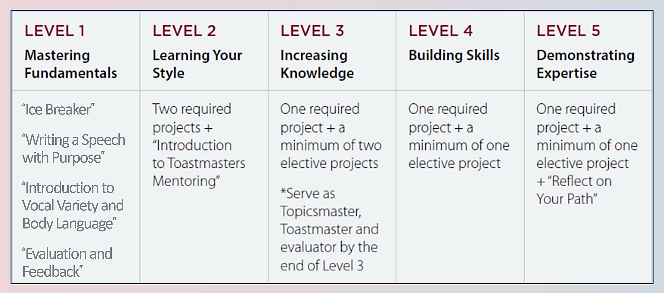
Levels and Projects
15 projects across all five levels — a combination of 11 required projects and 4 elective projects
Notes:
Old levels before oct 2025 update

Slide 11
Levels and Projects
Each path has various roles & 15 projects across the five levels – 11 required projects & 4 elective projects
Starting in Level 3, additional presentations are being added
Level 1 Mastering Fundamentals | Level 2 Learning Your Style | Level 3 Increasing Knowledge | Level 4 Building Skills | Level 5 Demonstrating Expertise
“Ice Breaker” “Writing a Speech with Purpose” “Introduction to Vocal Variety and Body Language” “Evaluation and Feedback” | Two Required Projects “Introduction to Toastmasters Mentoring” | One Required Project Two Elective Projects One Successful Club Series Presentation | One Required Project One Elective Project One Successful Club Series Presentation One Better Speaker Series Presentation | One Required Project One Elective Project Reflect On Your Path One Successful Club Series Presentation One Leadership Excellence Series Presentation
Serve As: Table Topics Speaker Evaluator Timer OR Ah-Counter | Serve As: Grammarian Topicsmaster Evaluator Toastmaster, Timer OR Ah-Counter | Serve As: Toastmaster Evaluator Topicsmaster, Table Topics Speaker, OR Introductory Mentor | Serve As: Toastmaster General Evaluator Evaluator Table Topics Speaker, Topicsmaster, a Special Role, OR repeat any above role | Serve As: General Evaluator (x2) Toastmaster (x2) Evaluator (x2) Table Topics Speaker, Topicsmaster, Ah-Counter, Timer, Grammarian, Club Mentor, a Special Role, OR repeat any above role

Slide 12
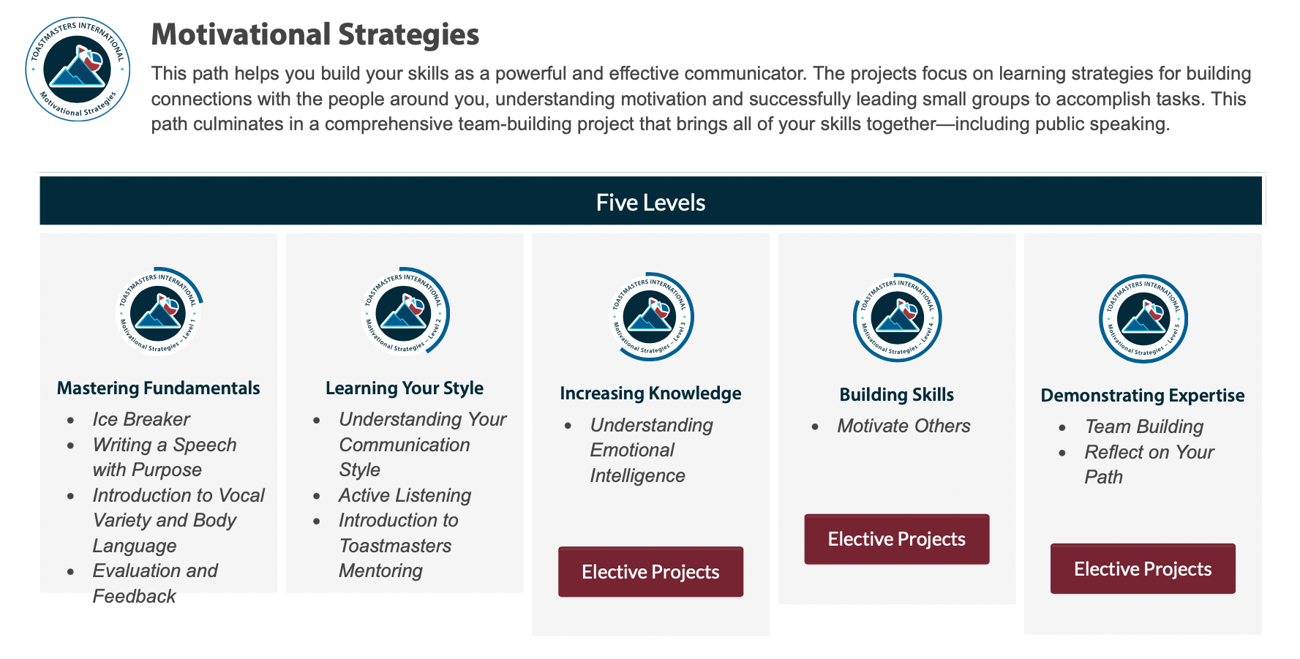

Slide 13
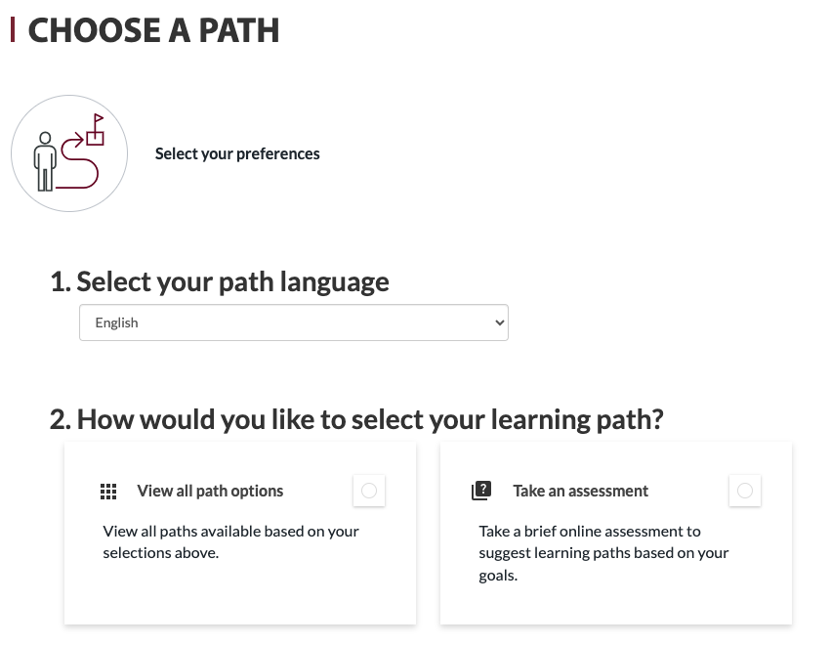
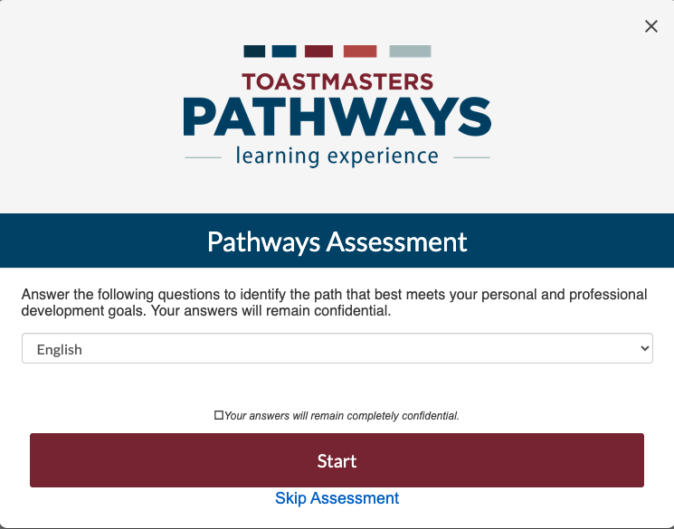
Picking a Path – the Assessment
When you go to choose your path, you will have the option to take an online assessment of your skills, interests, and goals. The assessment will recommend the three paths that best match your responses.

Slide 14
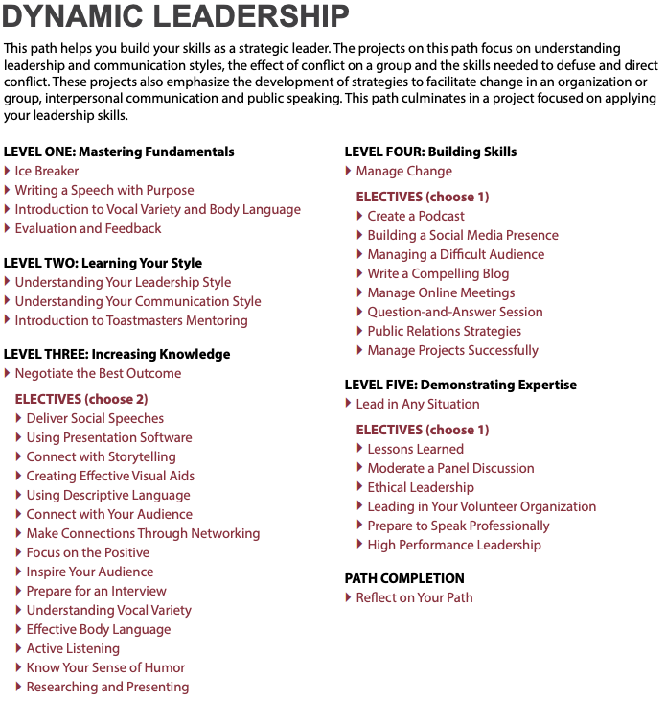
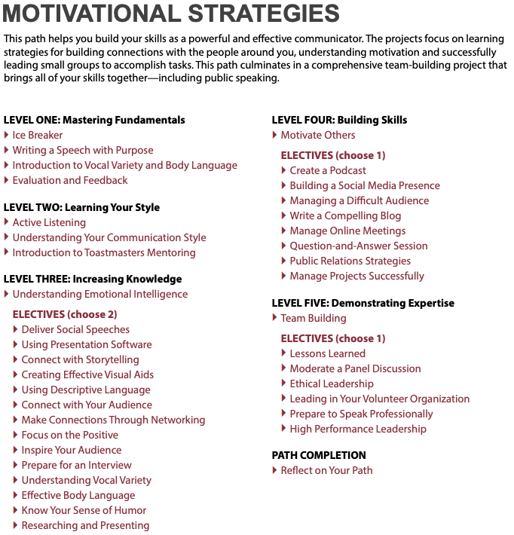
Picking a Path – the Catalog
Link to Catalog
You can use the catalog to compare descriptions and project breakdowns of each path to select the one you prefer. *Note: the electives are the same for all the paths – look at the required projects to help you choose a path.
VS

Slide 15
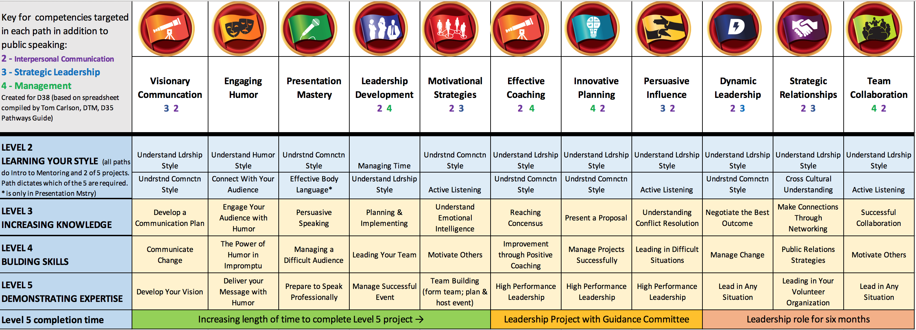
Picking a Path – Using the Chart
Created by D35 Tom Carlson, DTM

Slide 16
Picking a Path – Using the Chart
Paths represented by required projects and time to complete level 5
Created by D35 Tom Carlson, DTM
Created by D35 Tom Carlson, DTM
Leadership Project with guidance committee
Leadership role for 6 months

Slide 17
What are the Electives?
Connect with Storytelling
Connect with Your Audience
Creating Effective Visual Aids
Deliver Social Speeches
Effective Body Language
Focus on the Positive
Inspire Your Audience
Know Your Sense of Humor
Prepare for an Interview
Understanding Vocal Variety
Using Descriptive Language
Using Presentation Software
Researching and Presenting
Make Connections Through Networking
Write a Compelling Blog
Create a Podcast
Manage Online Meetings
Manage Projects Successfully
Public Relations Strategies
Question & Answer Sessions
Build a Social Media Presence
Ethical Leadership
High Performance Leadership
Leading in Your Volunteer Organization
Lessons Learned
Moderate a Panel Discussion
Level 3 Electives
Level 4 Electives
Level 5 Electives
Notes:
Choose 2 electives from Level 3 and one each from 4 & 5

Slide 18
Differences Between Updated and Legacy Paths
Updated Paths
Legacy Paths
Easy to see and understand side navigation
Complete Projects by clicking on a button
Speech Logs to help keep track of progress
Are being continuously enhanced
Include new role requirements
All navigation per project is done in the middle square
Must complete “Assess Your Skills – After” to complete project
No built in Speech Log
Don’t have new enhancements
Don’t have new role requirements

Slide 19
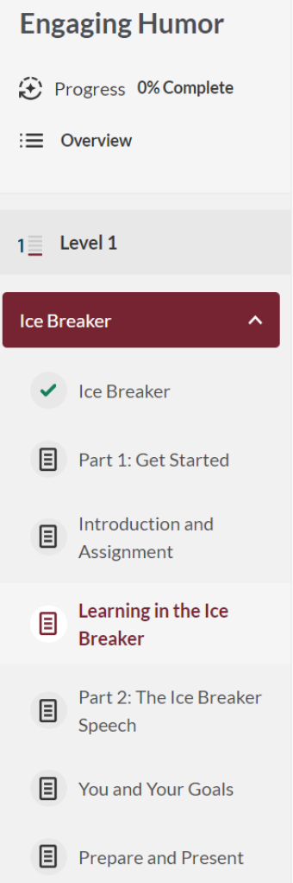
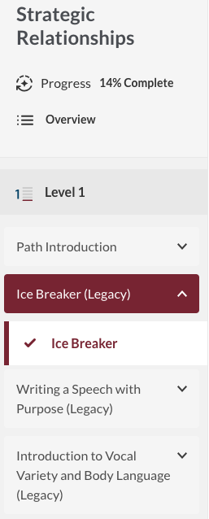
Differences Between Updated and Legacy Paths
Updated
Legacy

Slide 20
Role & Presentation Enhancements (Late Oct)
There is a new Meeting Role & Presentation Section being added to all 6 Paths
  This new section will be the first item in each level, before your projects
  Roles requirements start at Level 1, Presentation additions start at Level 3
The 12-15 minute presentations give you the opportunity to practice a different type of speaking by taking an existing presentation/deck and making it your own
  Successful Club Series - helps you understand what’s necessary for a club to deliver an excellent experience
  Better Speaker Series - provides our entire club with information that will help everyone improve their speech writing and delivery
  Leadership Excellence Series - helps foster stronger, more informed leaders in our club
https://www.toastmasters.org/magazine/magazine-issues/2025/october/pathways-additions-arrive

Slide 21
October 2025: Role & Speech Requirement Updates
Level | Meeting Roles | Presentation Requirements
Level 1 | Table Topics Speaker* Evaluator Timer OR Ah-Counter | None
Level 2 | Grammarian Topicsmaster Evaluator Toastmaster, Timer OR Ah-Counter | None
Level 3 | Toastmaster Evaluator Topicsmaster, Table Topics Speaker, OR Introductory Mentor** | Successful Club Series Presentation (Choose 1): Creating the Best Club Climate, Meeting Roles and Responsibilities, Keeping the Commitment, Going Beyond Our Club
Level 4 | Toastmaster General Evaluator Evaluator Table Topics Speaker, Topicsmaster, a Specialized Role***, OR repeat any above role | Successful Club Series Presentation (Choose 1): Finding New Members, Closing the Sale, How to Be a Distinguished Club, Toastmasters Educational Program Better Speaker Series Presentation (Choose 1): Beginning Your Speech, Concluding Your Speech, Controlling Your Fear, Impromptu Speaking, Selecting Your Topic, Know Your Audience, Organizing Your Speech, Creating an Introduction, Preparation and Practice, Using Body Language
Level 5 | General Evaluator (x2) Toastmaster (x2) Evaluator (x2) Table Topics Speaker, Topicsmaster, Ah-Counter, Timer, Grammarian, Club Mentor, a Specialized Role***, OR repeat any above role | Successful Club Series Presentation (Choose 1): Moments of Truth, Evaluate to Motivate, Mentoring Leadership Excellence Series Presentation (Choose 1): Service and Leadership, The Leader as a Coach, Developing a Mission, Motivating People, Building a Team, Delegate to Empower, Resolving Conflict, Visionary Leader, Values and Leadership, Goal Setting and Planning, Giving Effective Feedback
https://content.toastmasters.org/image/upload/club-officer-guide-to-2025-pathways-enhancements.pdf

Slide 22
October 2025: Role & Speech Requirement Updates
Level 1
Level 2
Level 3
Meeting Roles:
  Table Topics Speaker*
  Evaluator
  Timer or Ah-Counter
Education Series Presentations:
  None
Meeting Roles:
  Grammarian
  Topicsmaster
  Evaluator
  Toastmaster
  Timer or Ah-Counter
Education Series Presentations:
  None
Meeting Roles:
  Toastmaster
  Evaluator
  Topicsmaster, Table Topics Speaker or Introductory Mentor**
Successful Club Series Presentation (Choose 1):
  Creating the Best Club Climate
  Meeting Roles and Responsibilities
  Keeping the Commitment
  Going Beyond Our Club
*Table Topics Speaker must be completed before delivering an Ice Breaker speech
**An introductory mentor is a member who unofficially supports new members by answering questions and guiding them based on their own experiences.

Slide 23
October 2025: Role & Speech Requirement Updates
Level 4
Meeting Roles:
  Toastmaster
  General Evaluator
  Evaluator
  Table Topics Speaker, Topicsmaster, a Specialized Role***, or repeat any above role
Successful Club Series Presentation (Choose 1):
  Finding New Members
  Closing the Sale
  How to Be a Distinguished Club
  Toastmasters Educational Program
Better Speaker Series Presentation (Choose 1):
  Beginning Your Speech
  Concluding Your Speech
  Controlling Your Fear
  Impromptu Speaking
  Selecting Your Topic
  Know Your Audience
  Organizing Your Speech
  Creating an Introduction
  Preparation and Practice
  Using Body Language
*** Completing a specialized role allows you to fill a role that is specific to your club or a unique situation.

Slide 24
October 2025: Role & Speech Requirement Updates
Level 5
Meeting Roles:
  General Evaluator (x2)
  Toastmaster (x2)
  Evaluator (x2)
  Table Topics Speaker, Topicsmaster, Ah-Counter, Timer, Grammarian, Club Mentor, a Specialized Role***, or repeat any above role
Successful Club Series Presentation (Choose 1):
  Moments of Truth
  Evaluate to Motivate
  Mentoring
Leadership Excellence Series Presentation: (Choose 1):
  Service and Leadership
  The Leader as a Coach
  Developing a Mission
  Motivating People
  Building a Team
  Delegate to Empower
  Resolving Conflict
  Visionary Leader
  Values and Leadership
  Goal Setting and Planning
  Giving Effective Feedback
*** Completing a specialized role allows you to fill a role that is specific to your club or a unique situation.

Slide 25
October 2025 Presentation Additions
Level 3
Successful Club Series (Choose 1):
Creating the Best Club Climate
Meeting Roles and Responsibilities
Keeping the Commitment
Going Beyond Our Club
Level 4
Successful Club Series (Choose 1):
Finding New Members
Closing the Sale
How to Be a Distinguished Club
Toastmasters Educational Program
Level 5
Successful Club Series (Choose 1):
Moments of Truth
Evaluate to Motivate
Mentoring
Leadership Excellence (Choose 1):
Service and Leadership
The Leader as a Coach
Developing a Mission
Motivating People
Building a Team
Delegate to Empower
Resolving Conflict
Visionary Leader
Values and Leadership
Goal Setting and Planning
Giving Effective Feedback

Slide 26
Pathways Levels – Combined Reference Guide
 | Required Speeches & Projects | Meeting Roles | Presentation Requirements
Level 1 Mastering Fundamentals | • Ice Breaker • Writing a Speech with Purpose • Introduction to Vocal Variety and Body Language • Evaluation and Feedback | • Table Topics Speaker • Evaluator • Timer OR Ah-Counter | None
Level 2 Learning Your Style | • Introduction to Toastmasters Mentoring • Plus two required projects (varies by path) | • Grammarian • Topicsmaster • Evaluator • Toastmaster, Timer OR Ah-Counter | None
Level 3 Increasing Knowledge | • One required project • Minimum of two elective projects | • Toastmaster • Evaluator • Topicsmaster, Table Topics Speaker, OR Introductory Mentor | Successful Club Series Presentation (Choose 1): Creating the Best Club Climate, Meeting Roles and Responsibilities, Keeping the Commitment, Going Beyond Our Club
Level 4 Building Skills | • One required project • Minimum of one elective project | • Toastmaster • General Evaluator • Evaluator • Table Topics Speaker, Topicsmaster, a Specialized Role, OR repeat any above role | Successful Club Series Presentation (Choose 1): Finding New Members, Closing the Sale, How to Be a Distinguished Club, Toastmasters Educational Program Better Speaker Series Presentation (Choose 1): Beginning Your Speech, Concluding Your Speech, Controlling Your Fear, Impromptu Speaking, Selecting Your Topic, Know Your Audience, Organizing Your Speech, Creating an Introduction, Preparation and Practice, Using Body Language
Level 5 Demonstrating Expertise | • One required project • Minimum of one elective project • Reflect on Your Path | • General Evaluator (x2) • Toastmaster (x2) • Evaluator (x2) • Table Topics Speaker, Topicsmaster, Ah-Counter, Timer, Grammarian, Club Mentor, a Specialized Role, OR repeat any above role | Successful Club Series Presentation (Choose 1): Moments of Truth, Evaluate to Motivate, Mentoring Leadership Excellence Series Presentation (Choose 1): Service and Leadership, The Leader as a Coach, Developing a Mission, Motivating People, Building a Team, Delegate to Empower, Resolving Conflict, Visionary Leader, Values and Leadership, Goal Setting and Planning, Giving Effective Feedback

Slide 27
Navigating Base Camp
How To’s with Pictures

Slide 28
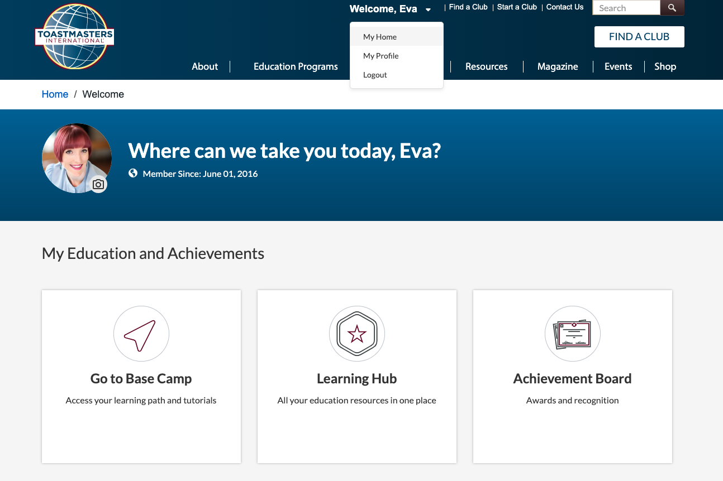
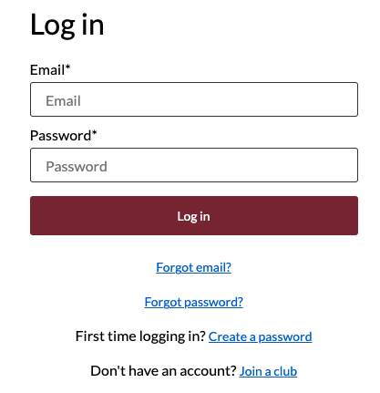
How to Access Base Camp
Go to https://www.toastmasters.org and log in using your email address and password
  If this is the first time you are logging in, click “Create a password” and enter the email you put on your Toastmasters application then create a password
Once you are logged in, click on the the drop down by your name and select “My Home” and click on the card “Go to Base Camp”

Slide 29
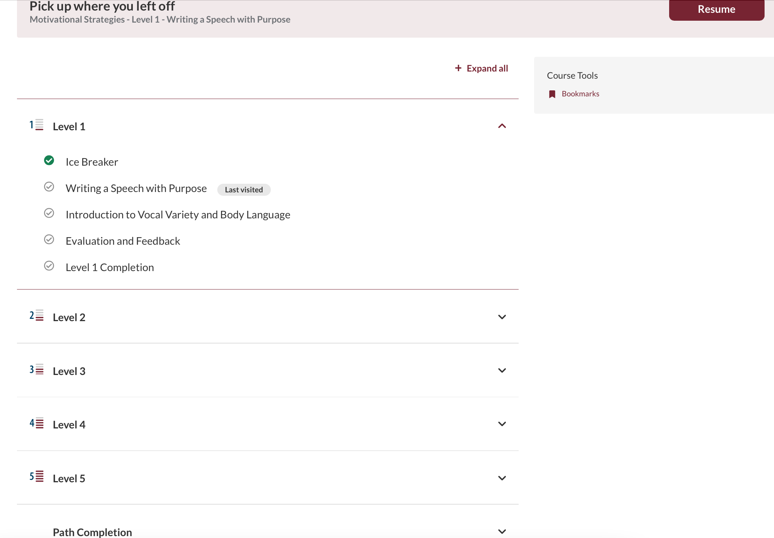
Opening Your Path - Overview

Slide 30
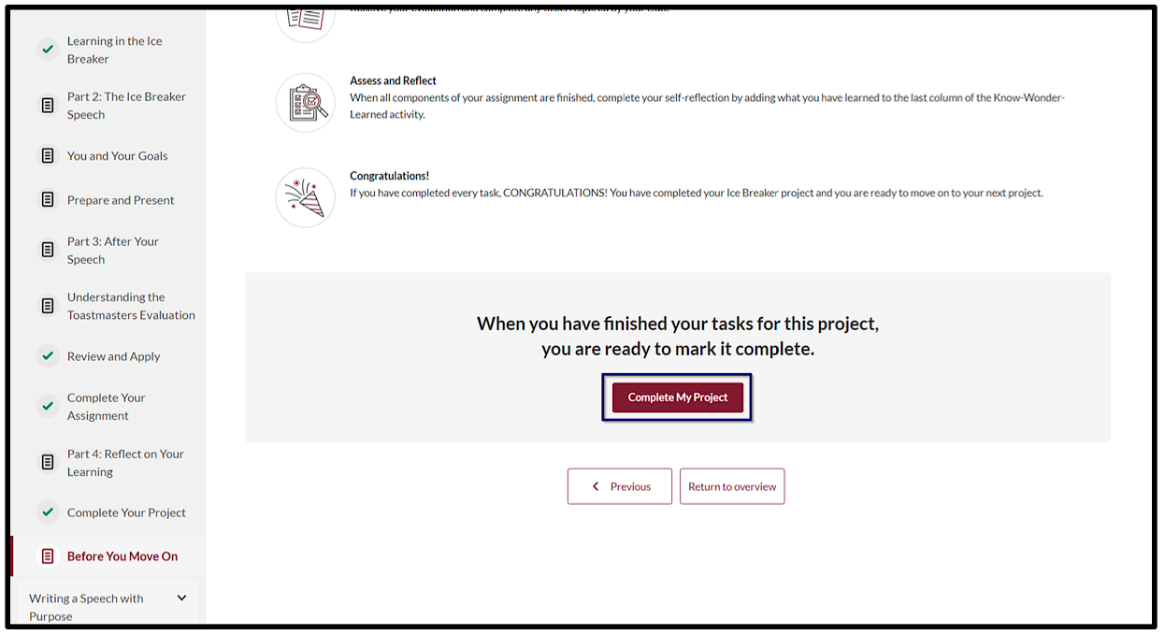
Completing a Project – Mark Complete

Slide 31
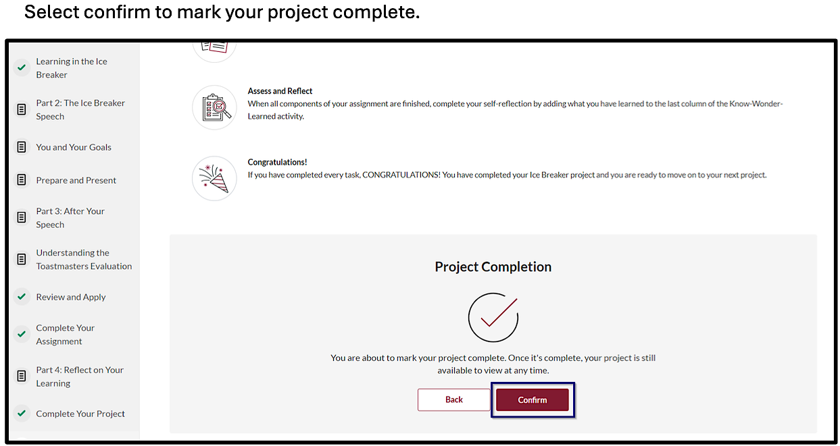
Completing a Project – Mark Complete

Slide 32
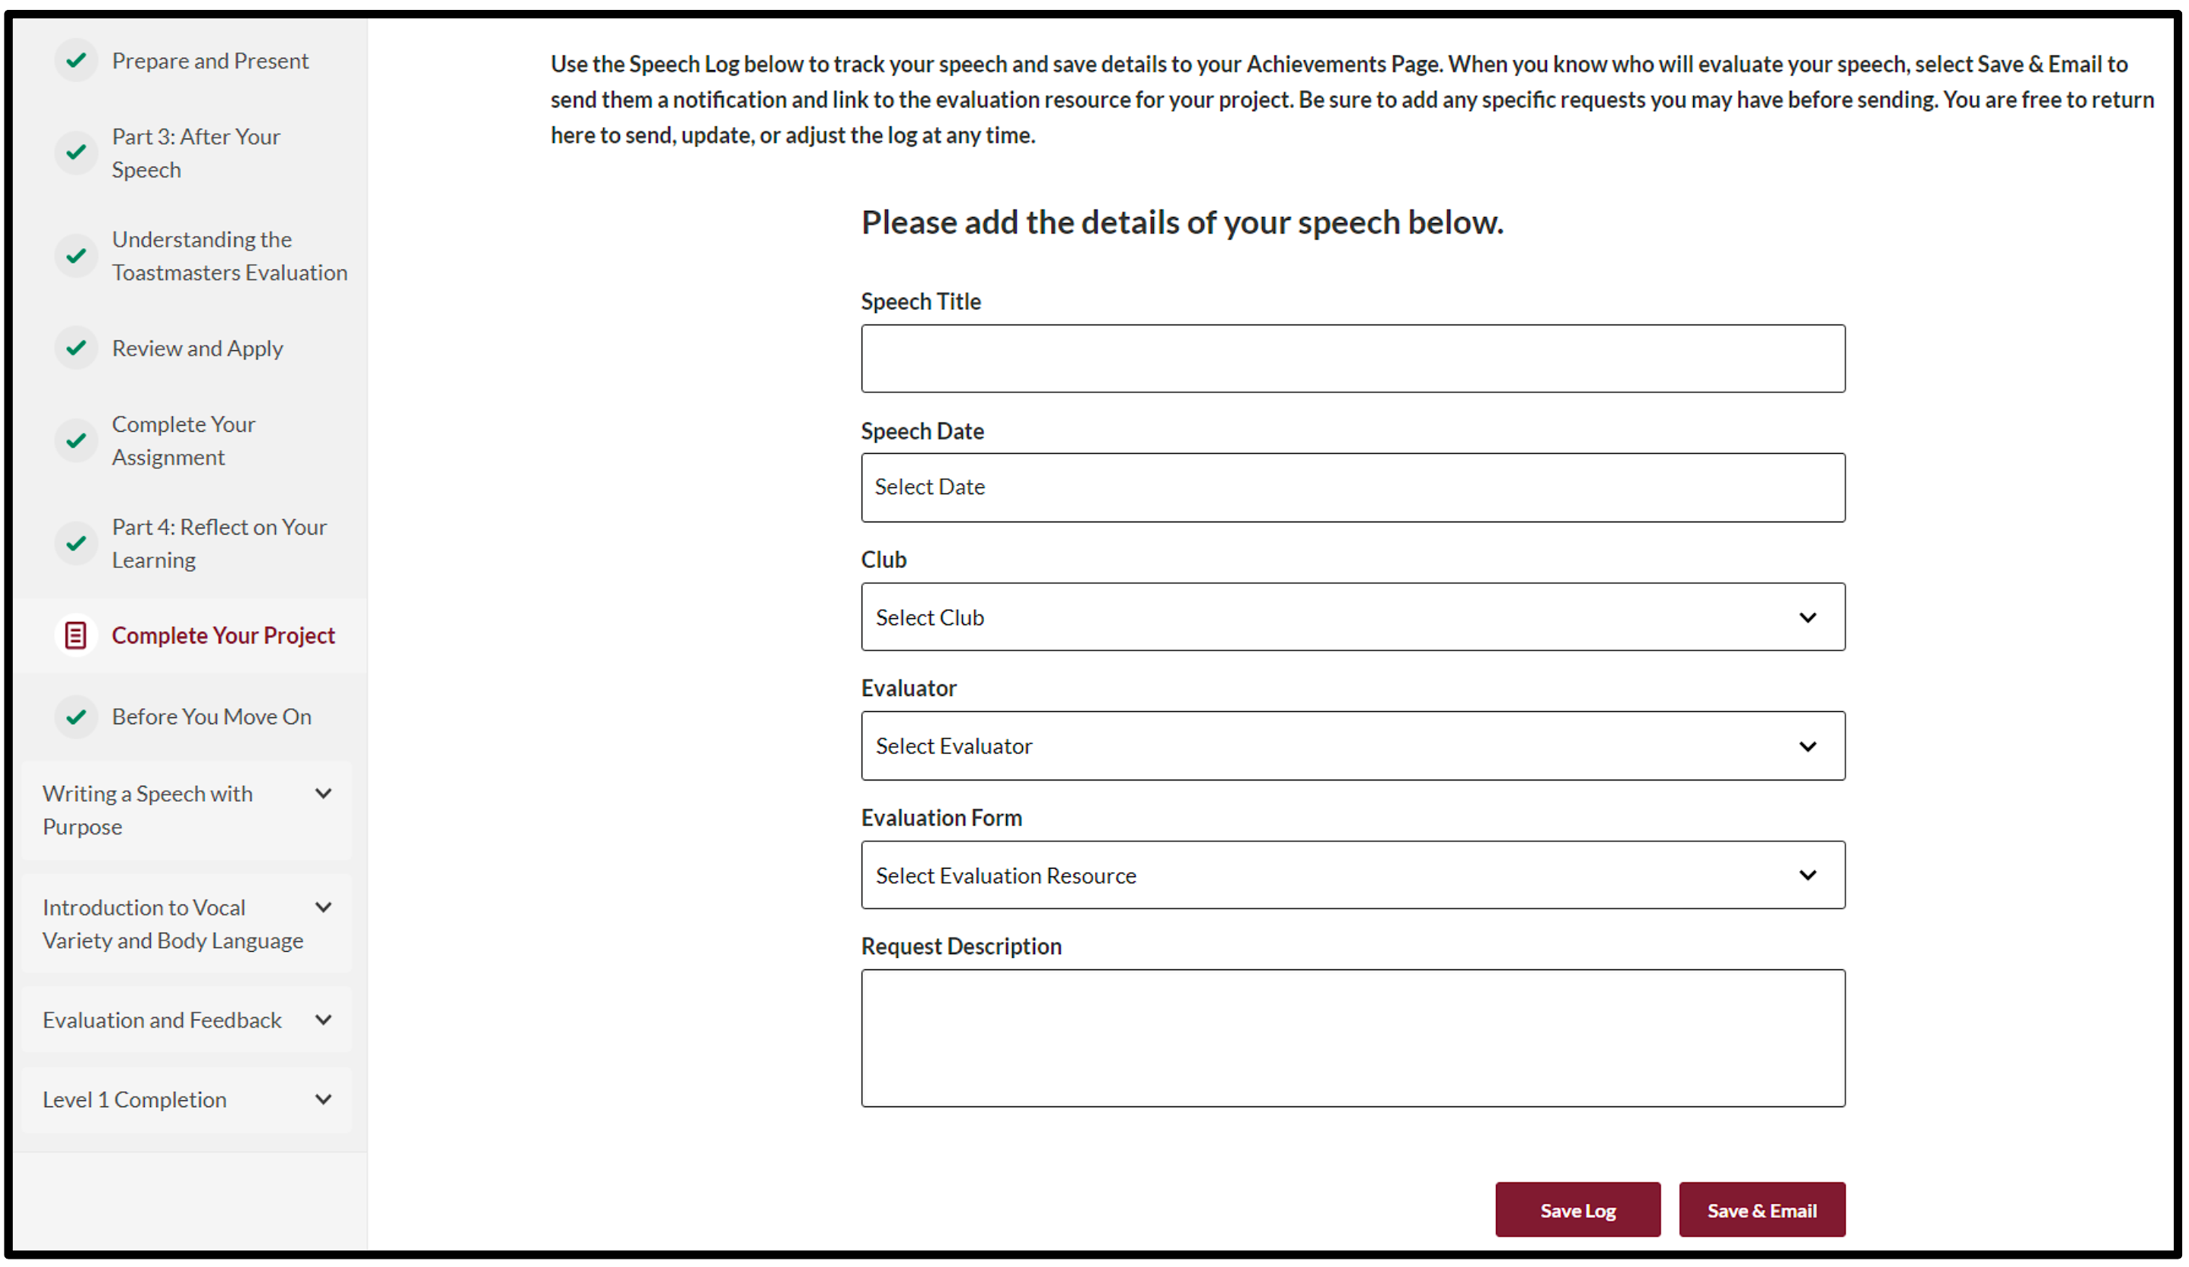
Completing a Speech Log – Within the Project

Slide 33
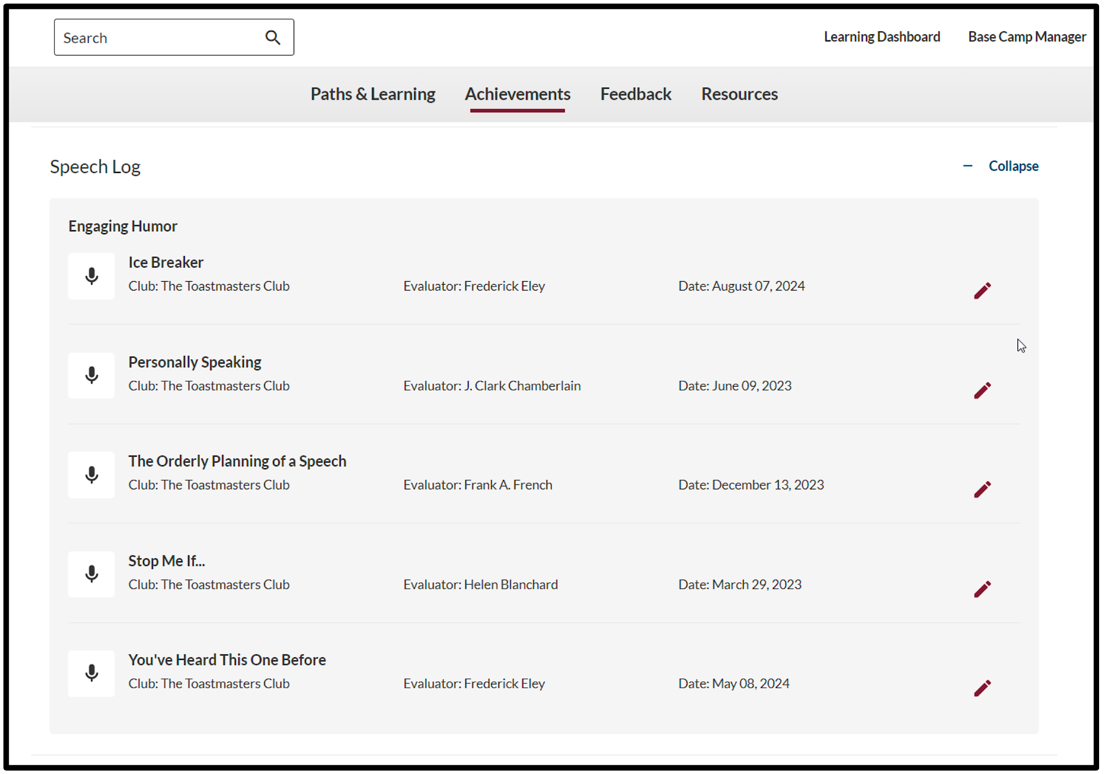
Speech Log

Slide 34
Evaluations – Requesting via Speech Log

Slide 35
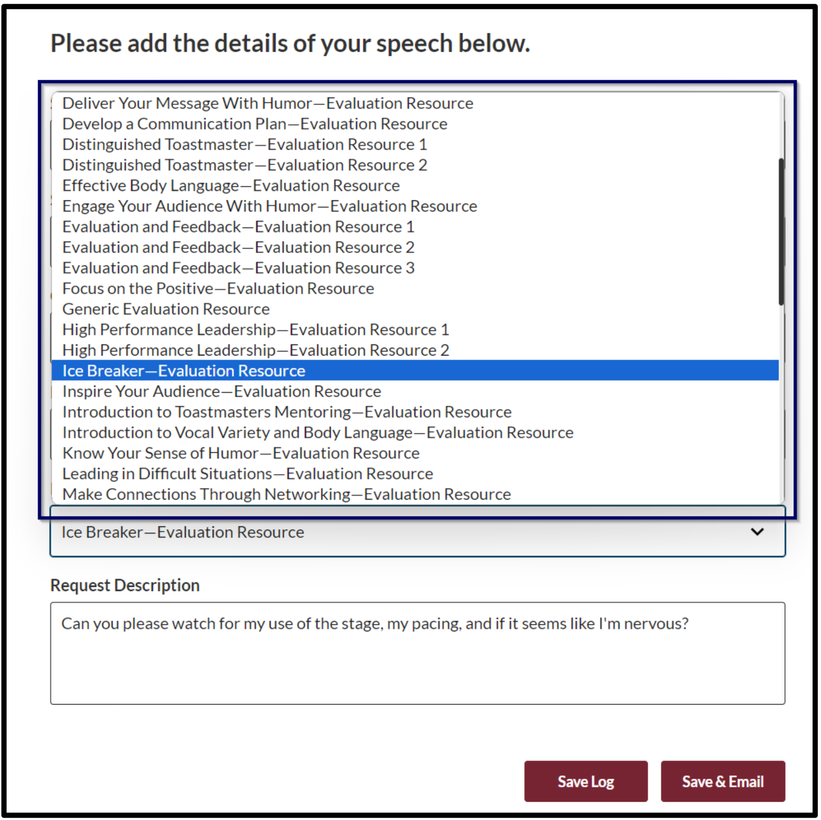
Evaluations – Requesting via Speech Log

Slide 36
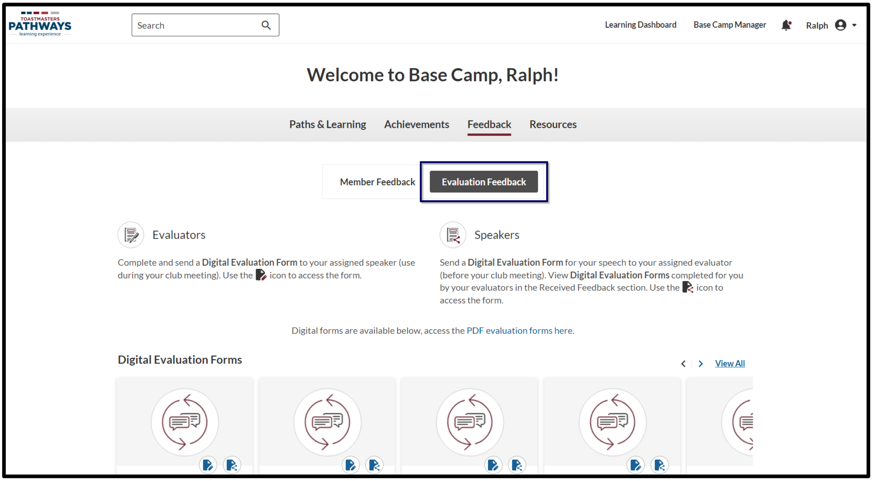
Evaluations – Requesting via Feedback Section
Notes:
This is how you send someone the evaluation form for your speech so they can fill it out using the Feedback section of Base Camp.

Slide 37
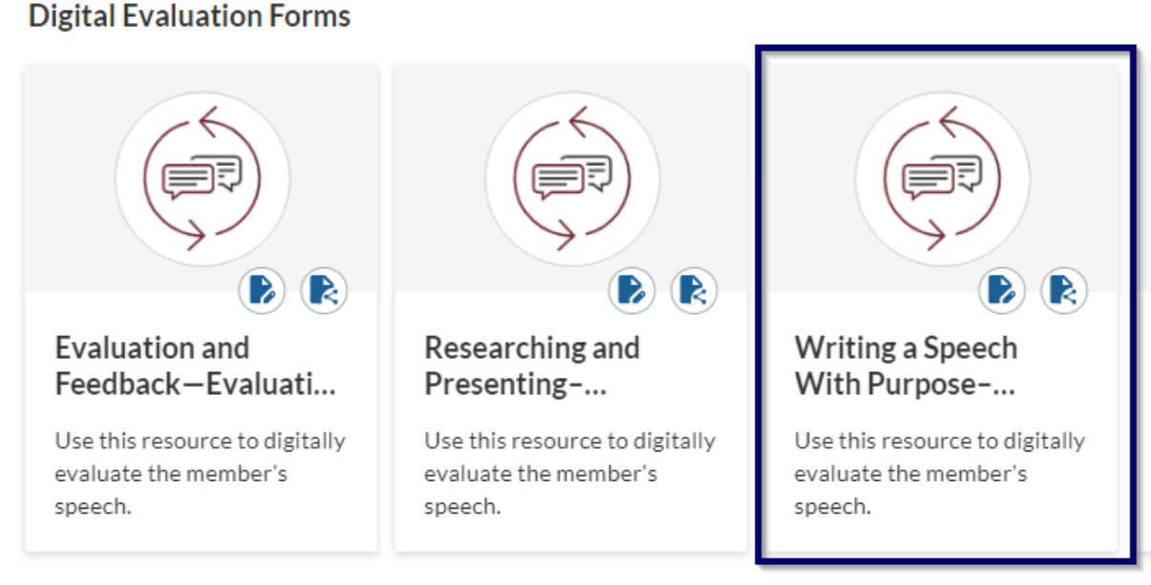
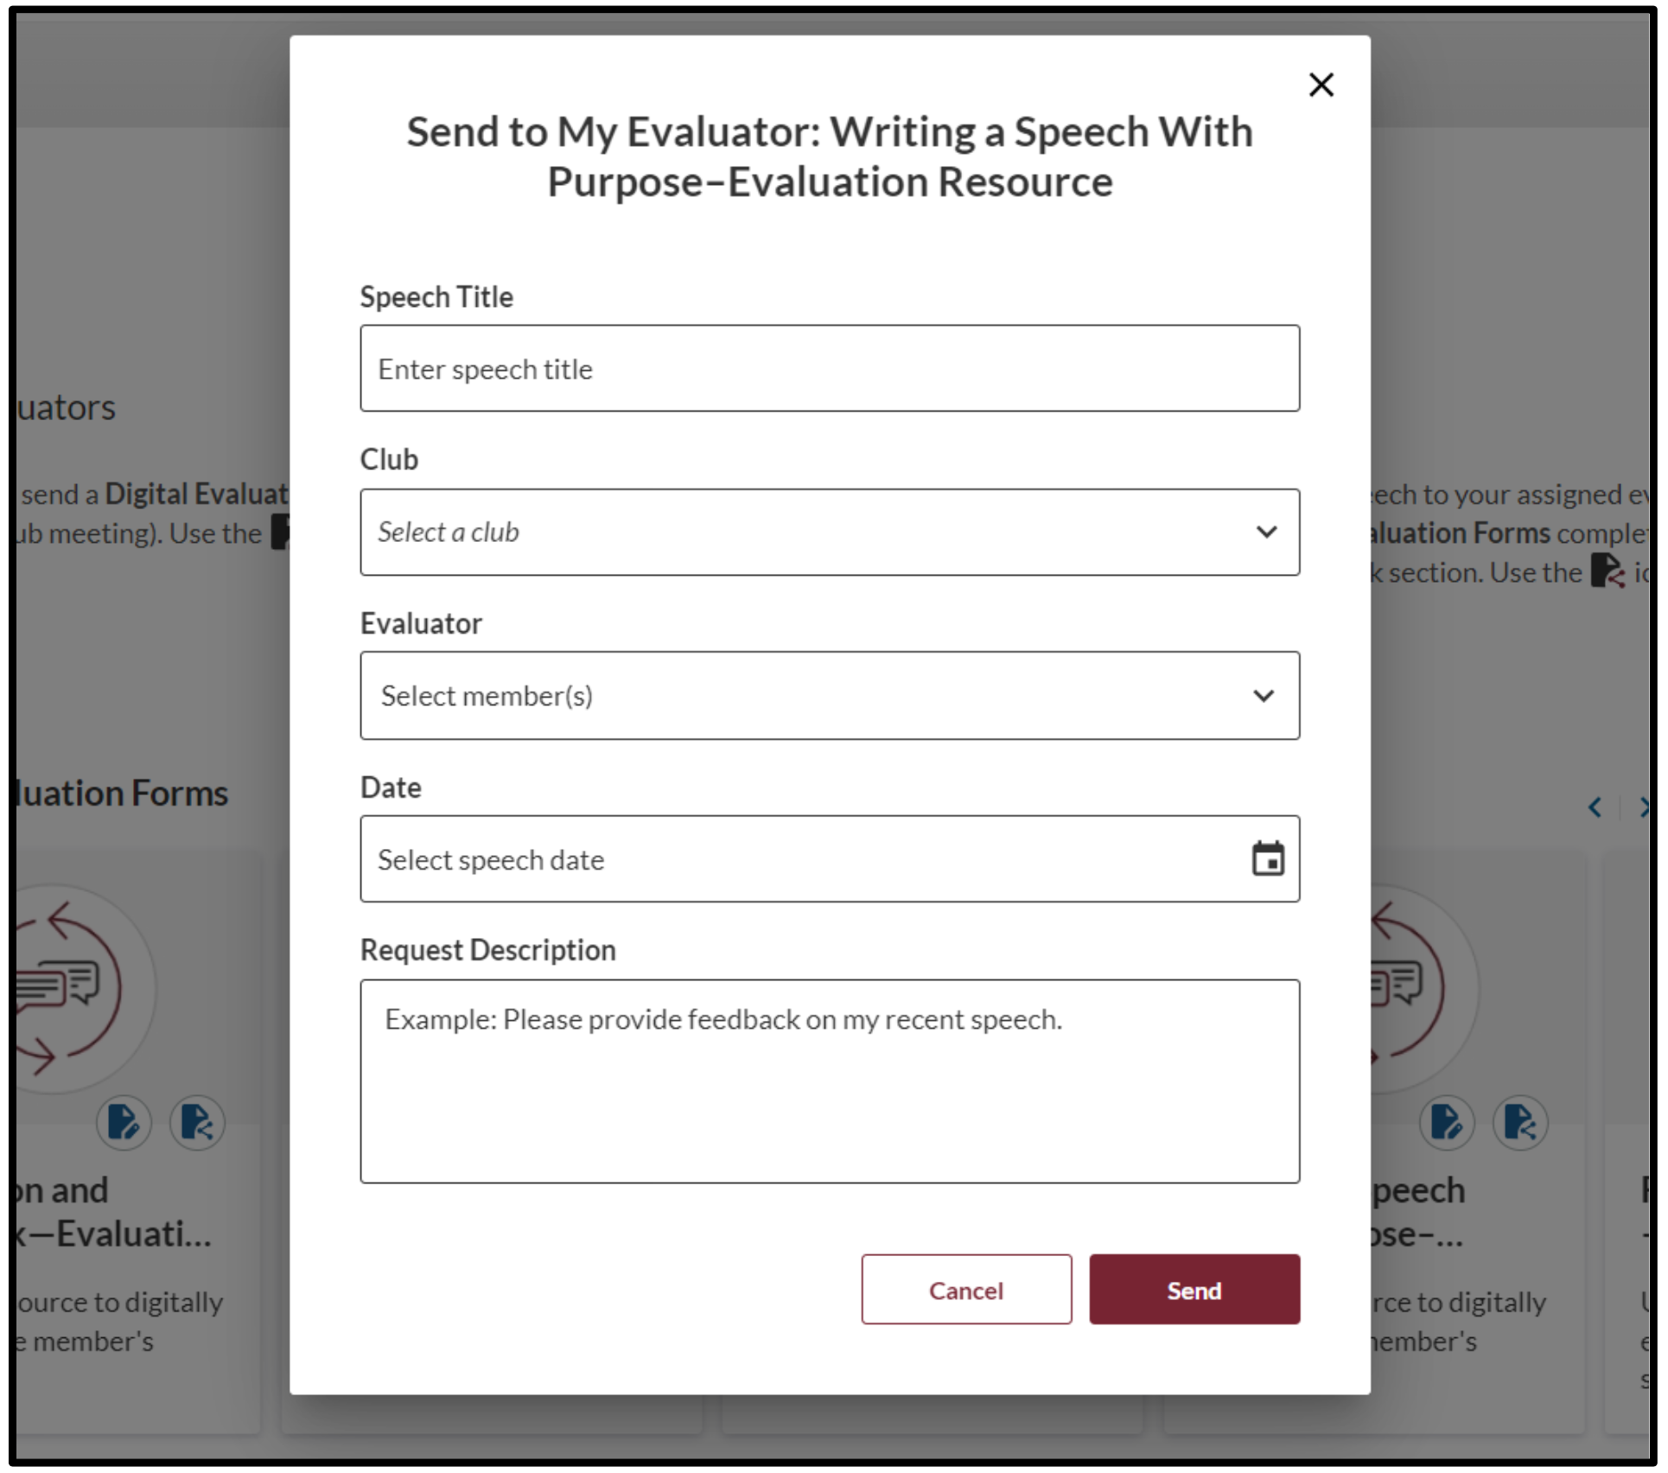

Evaluations – Requesting via Feedback Section
Notes:
This is how you send someone the evaluation form for your speech so they can fill it out using the Feedback section of Base Camp.

Slide 38
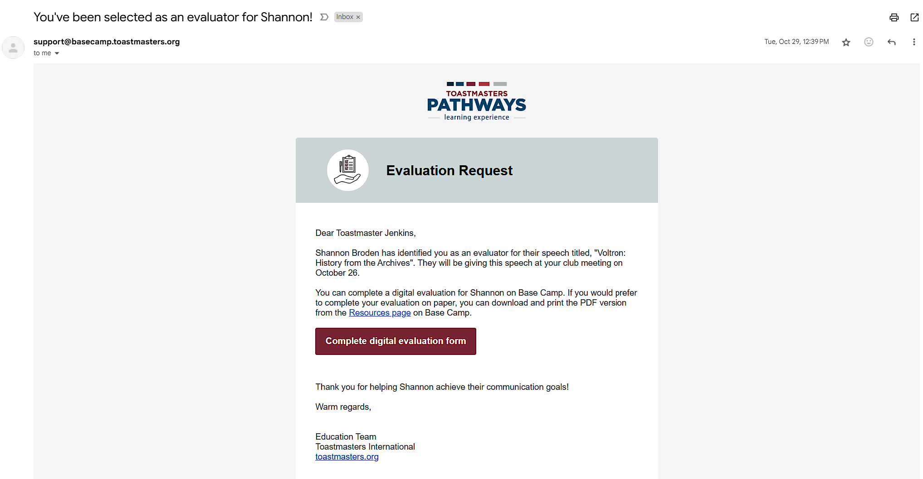
Evaluations – Request Notification Email

Slide 39
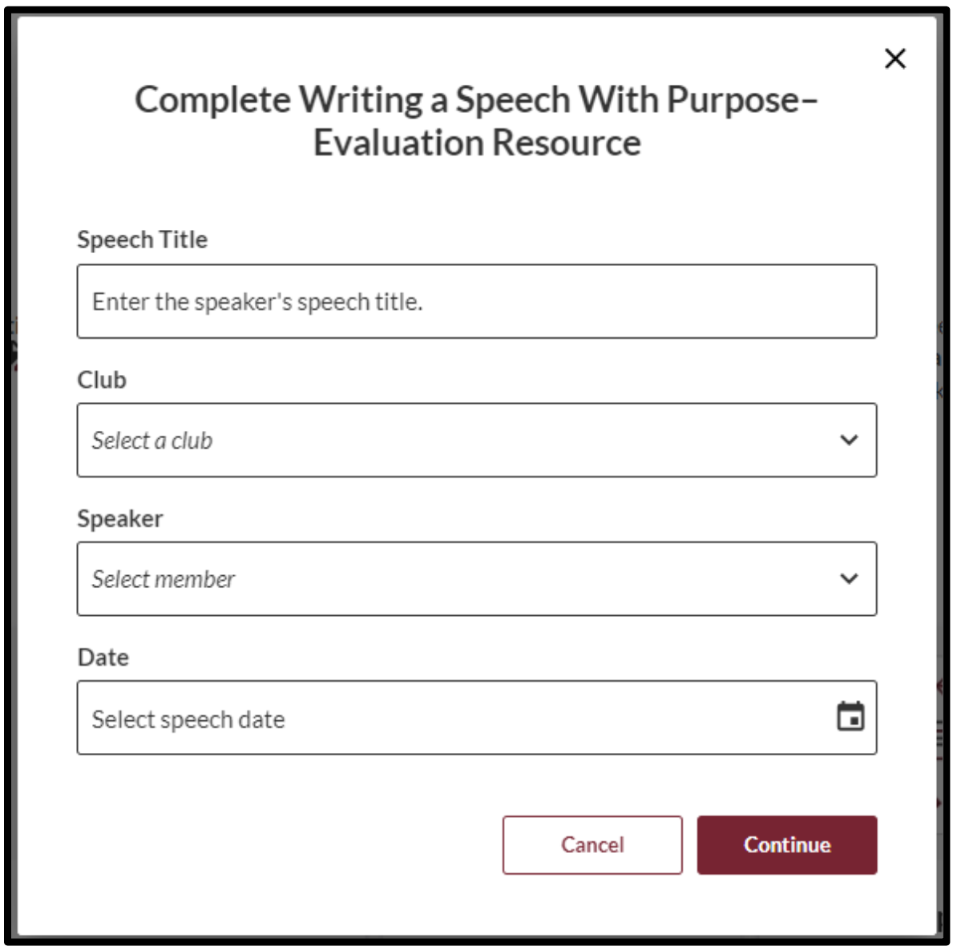

Evaluations – Providing Eval via Feedback Section
Notes:
This is how you fill out and send a speech evaluation form to a member of your club (if they did not send you a request)

Slide 40
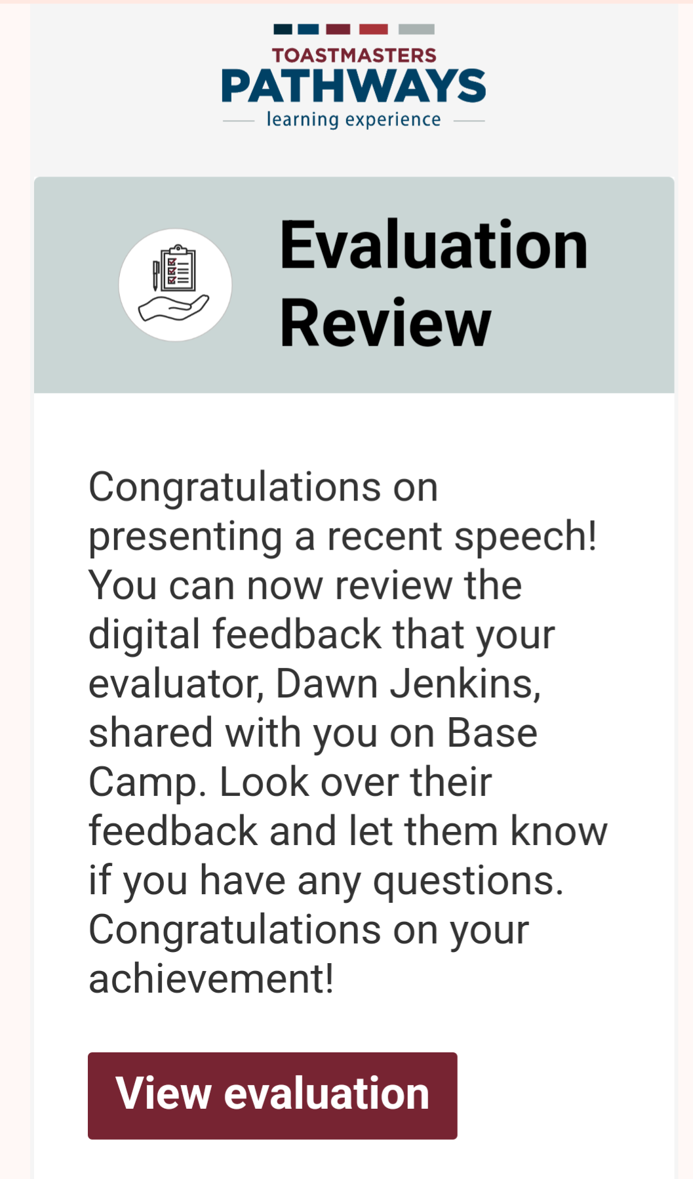
Evaluations – Finding Your Received Evaluation
Once your evaluator has filled out the form, you should receive an email notification with a link to view your evaluation
  If you don’t get it, check your spam folder & your communication permissions on Toastmasters.org under your profile “My Privacy & Consents”
You can also access your evaluation forms sent to you by your evaluators online on Base Camp

Slide 41
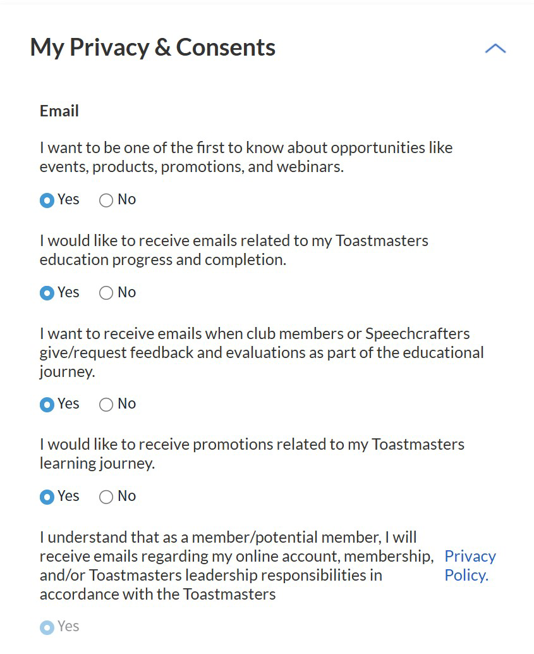
Enable Notification Emails
Make sure you have this option selected as “Yes” or you will NOT get any emails with evaluation requests or with completed forms from your evaluators

Slide 42
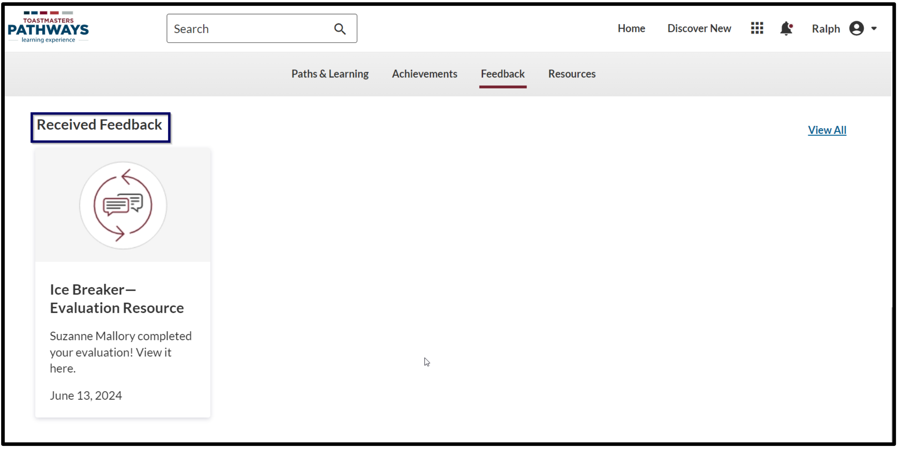
Evaluations – Finding Your Received Evaluation
Find your evaluation forms sent to you by your evaluators on Base Camp

Slide 43
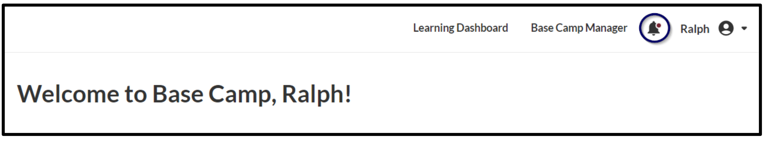
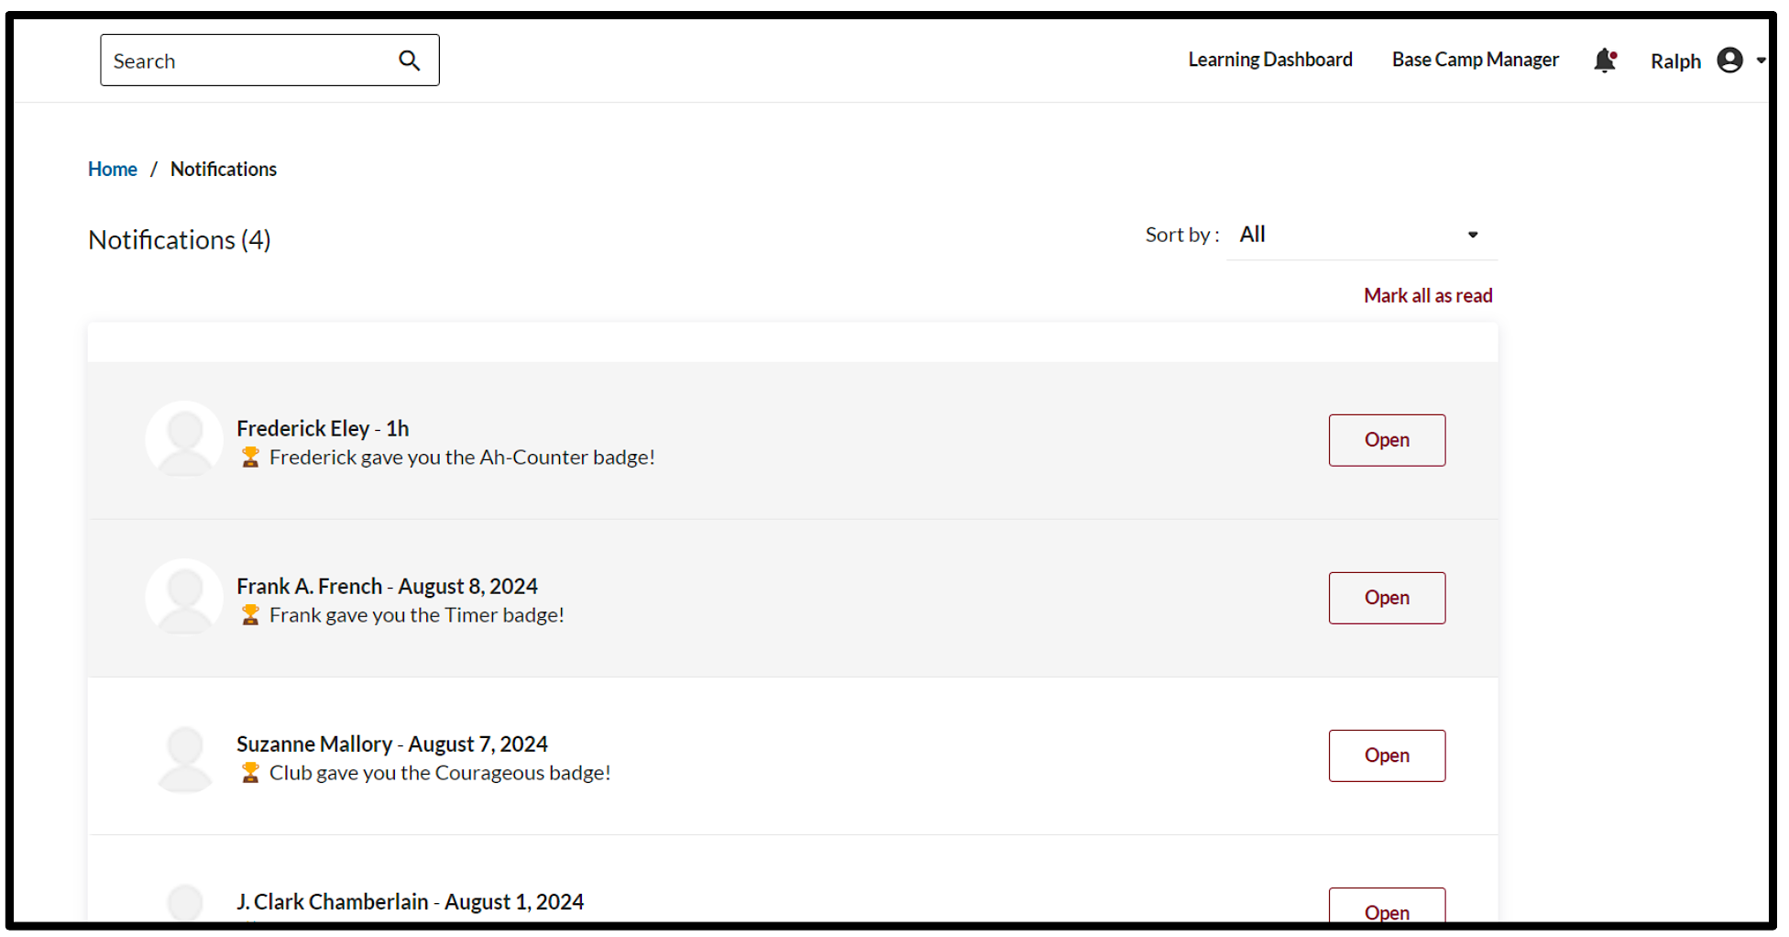
Evaluations – Finding Your Received Evaluation

Slide 44
More Advanced Base Camp Tutorials

Slide 45
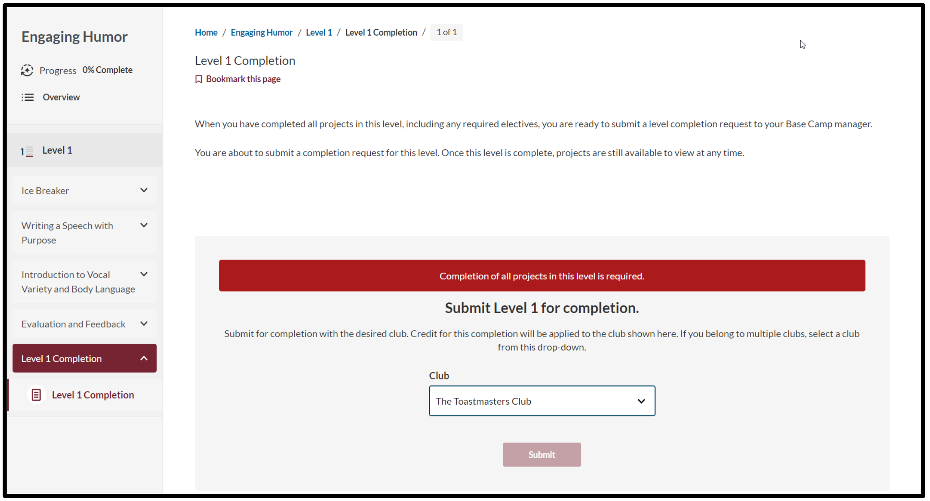
Completing a Level – Select Correct Club

Slide 46
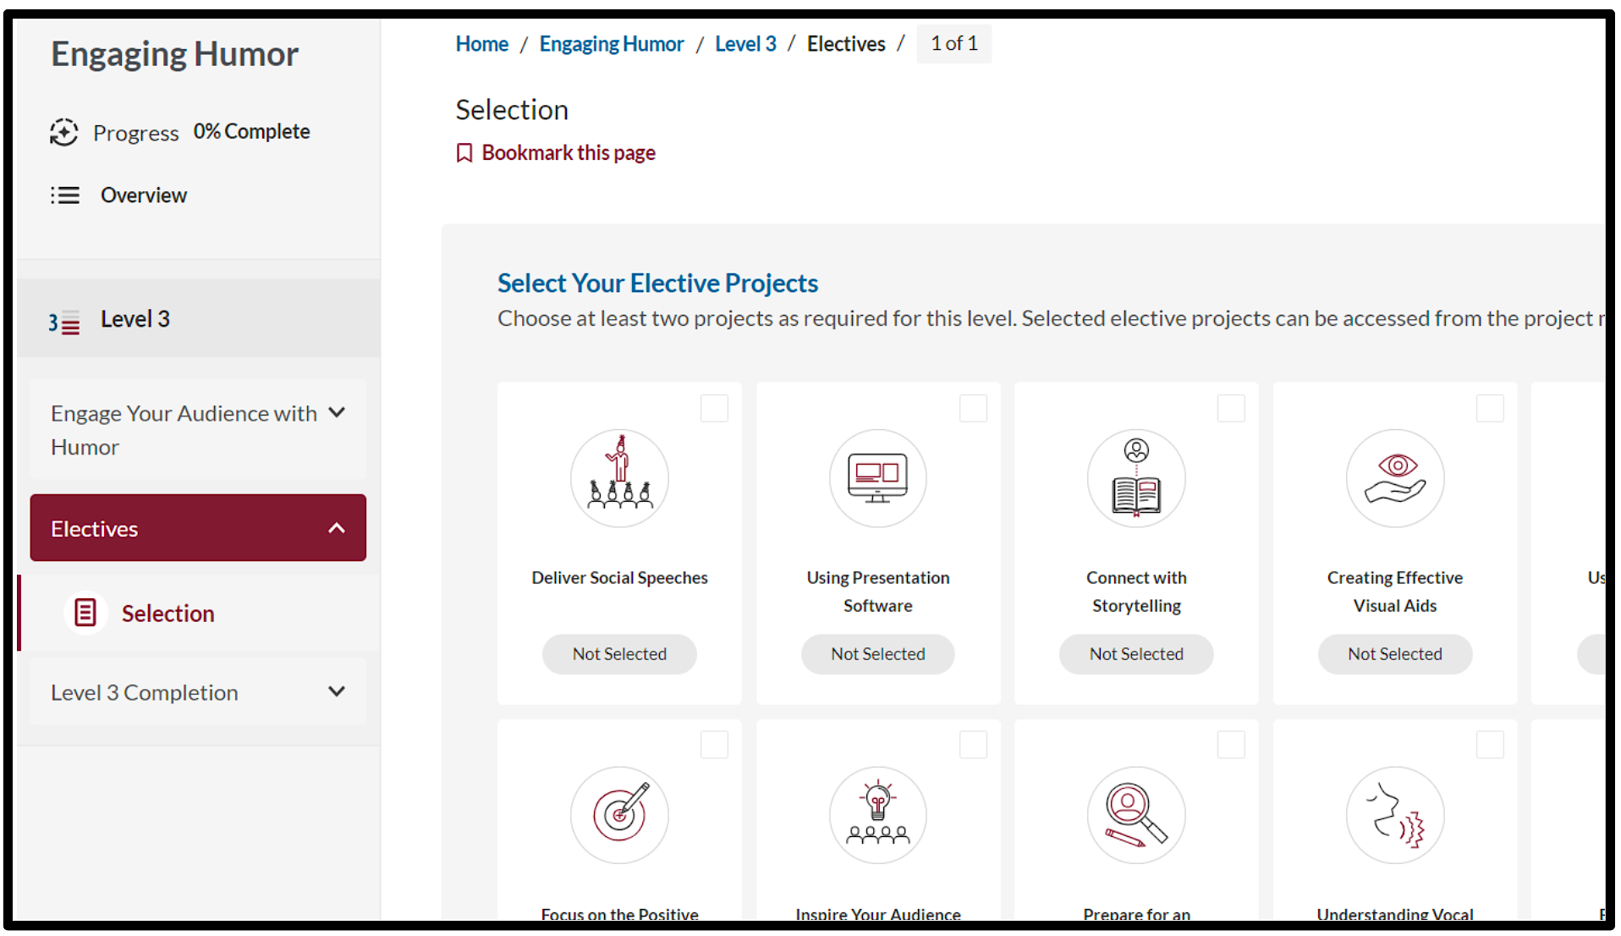
Electives – View Options

Slide 47
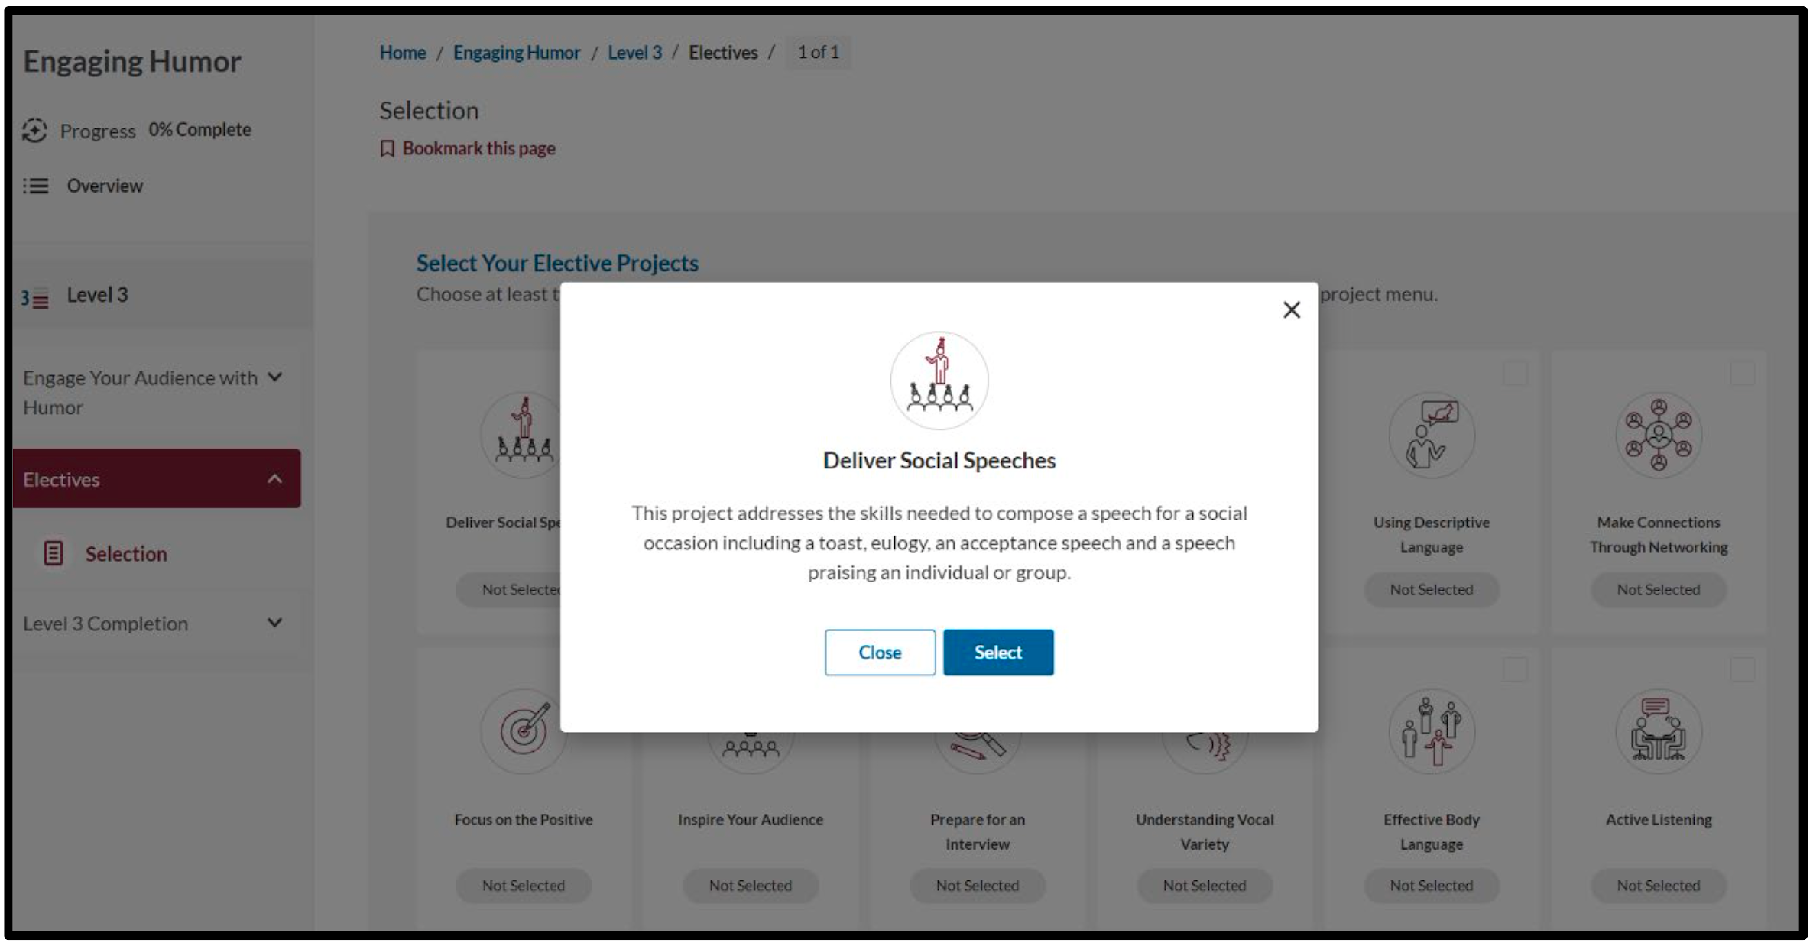
Electives – Select Desired Elective

Slide 48
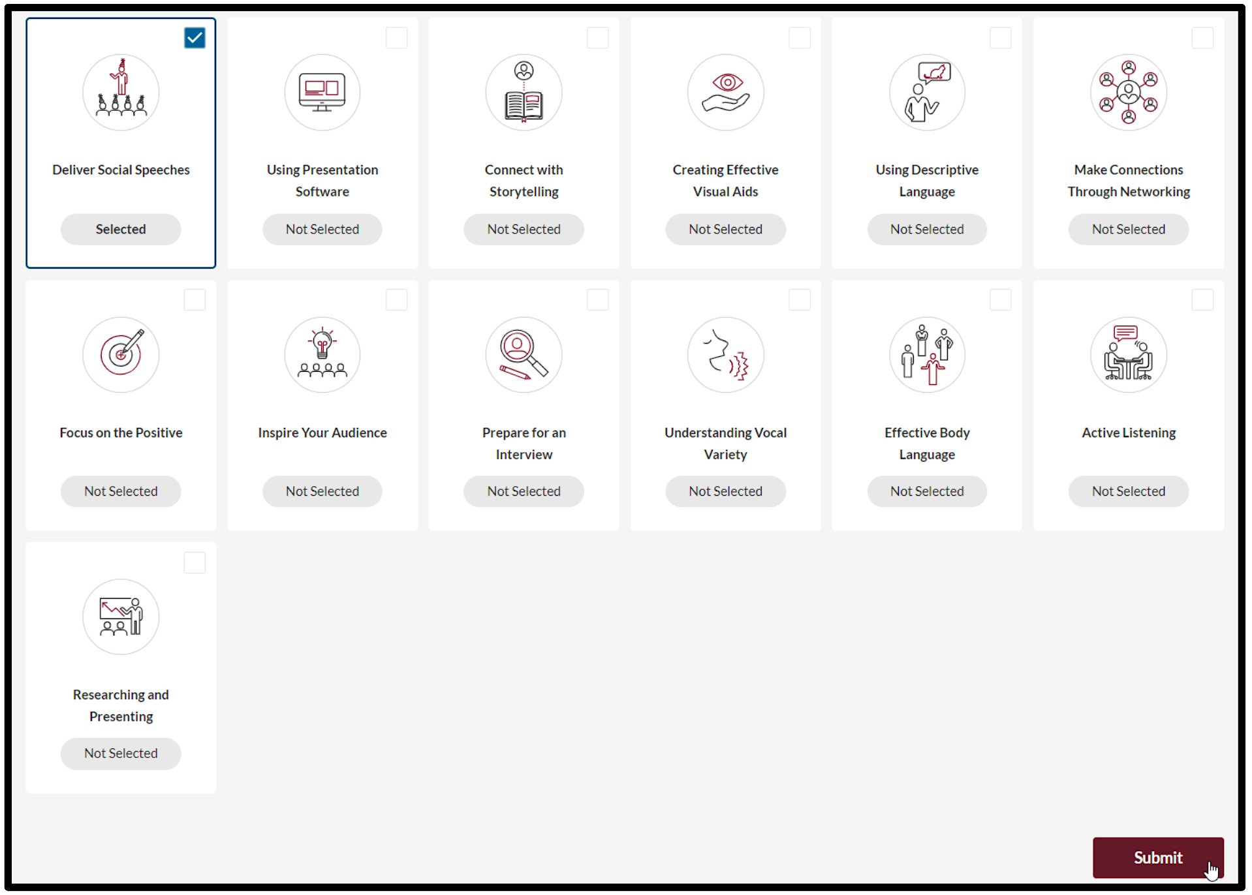
Electives – Select Desired Elective

Slide 49
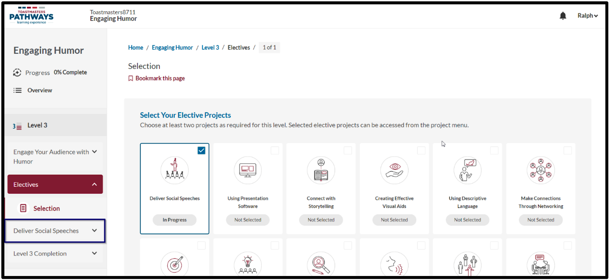
Electives – Select Desired Elective

Slide 50
Base Camp Manager Tutorials

