Slide 1
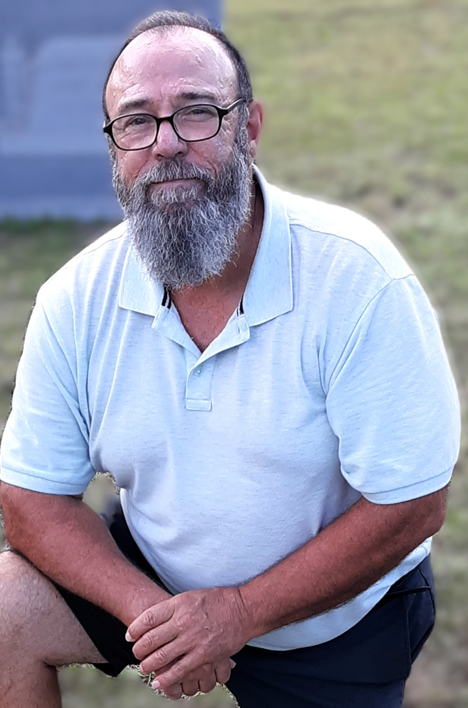
District Finance Manager
Jeff Puckett
Finance@tmd55.org
757.376.0466

Slide 2
District Finance Manager Report for May 2025
All the Best to All District Candidates!
Its Conference Time! ¡Viva Fiesta!
Finances are “Fine” For Now
All Reimbursement Requests Submitted via “Concur” Cleared
Training Opportunities
Concur Account Request Form

Slide 3
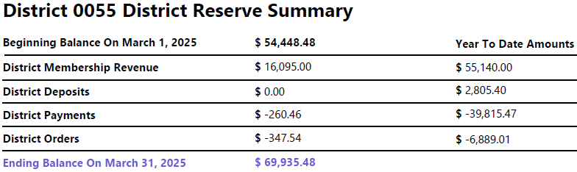
District Finance Manager

Slide 4
District Finance Manager

Slide 5


Slide 6
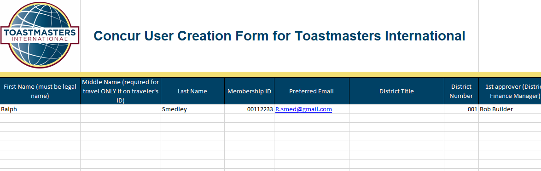
District Finance Manager

